Slide 1

Competitive Cyber Security Organization
Introductory General Body Meeting
Please sit up front :)
Notes:
Alec

Slide 2
Agenda
What kind of club is this?
Your Exec board
What you’ll learn
Dues
Competitions
Meeting Challenge, demos, questions
Notes:
Alec

Slide 3

Who we are / What we Do
Mentor
Teach a variety of cybersecurity topics
Empower students with technical and non-technical skills
Hands-on time to practice
Foster self-learning and continual improvement
Cultivate community of talented individuals
Compete
Represent Penn State in cyber competitions
Travel to competitions and conferences
Network and build your resume
Notes:
Josh

Slide 4
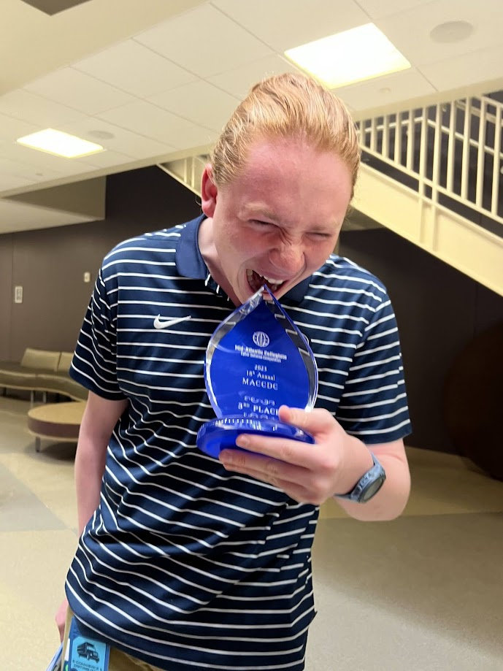
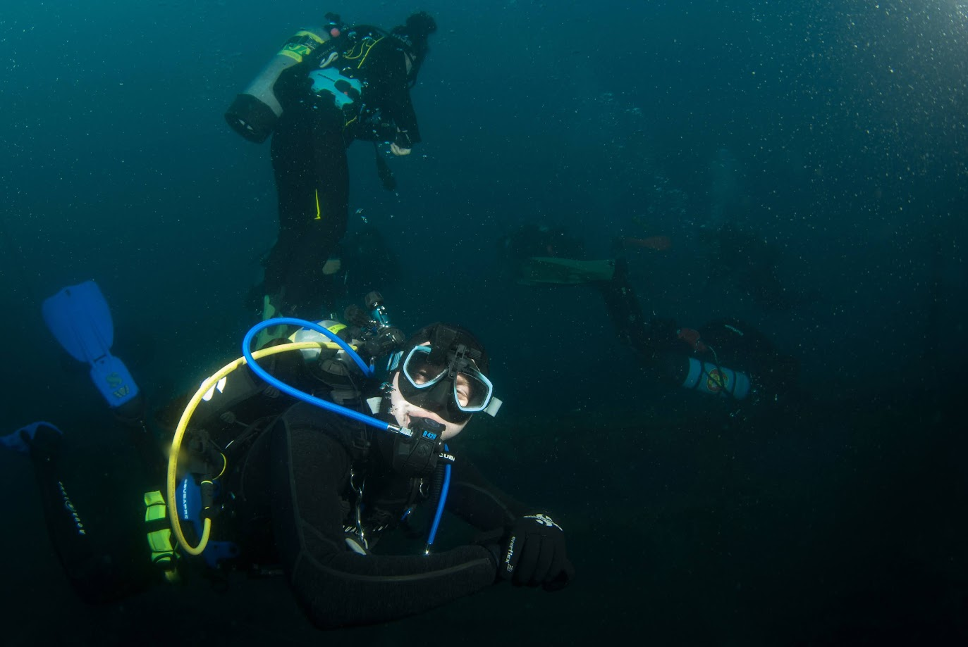
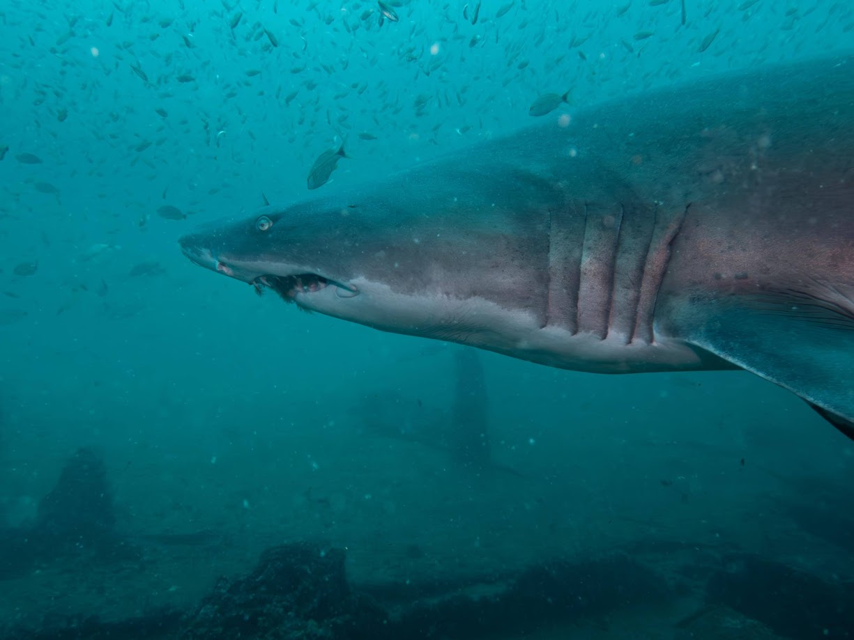
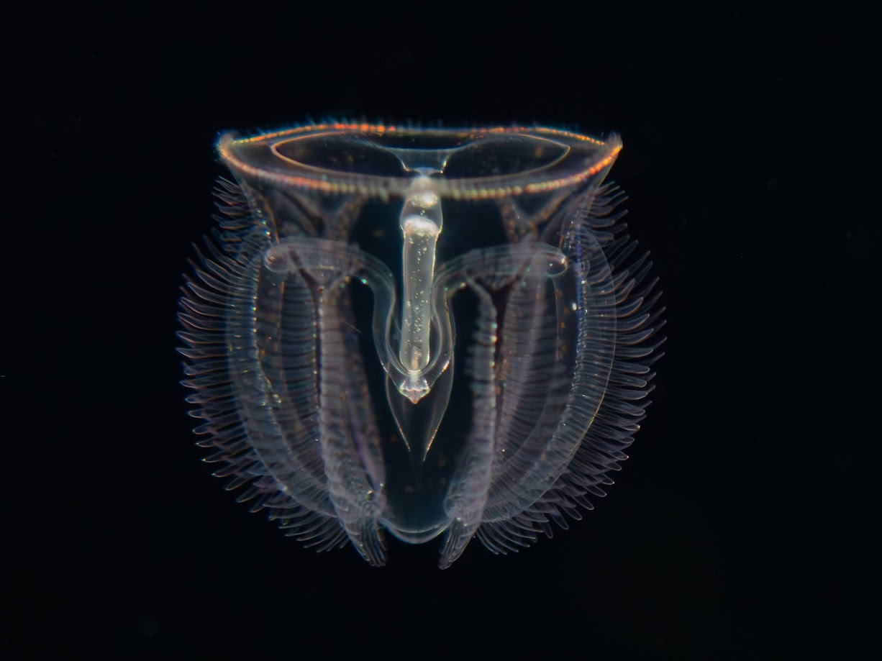
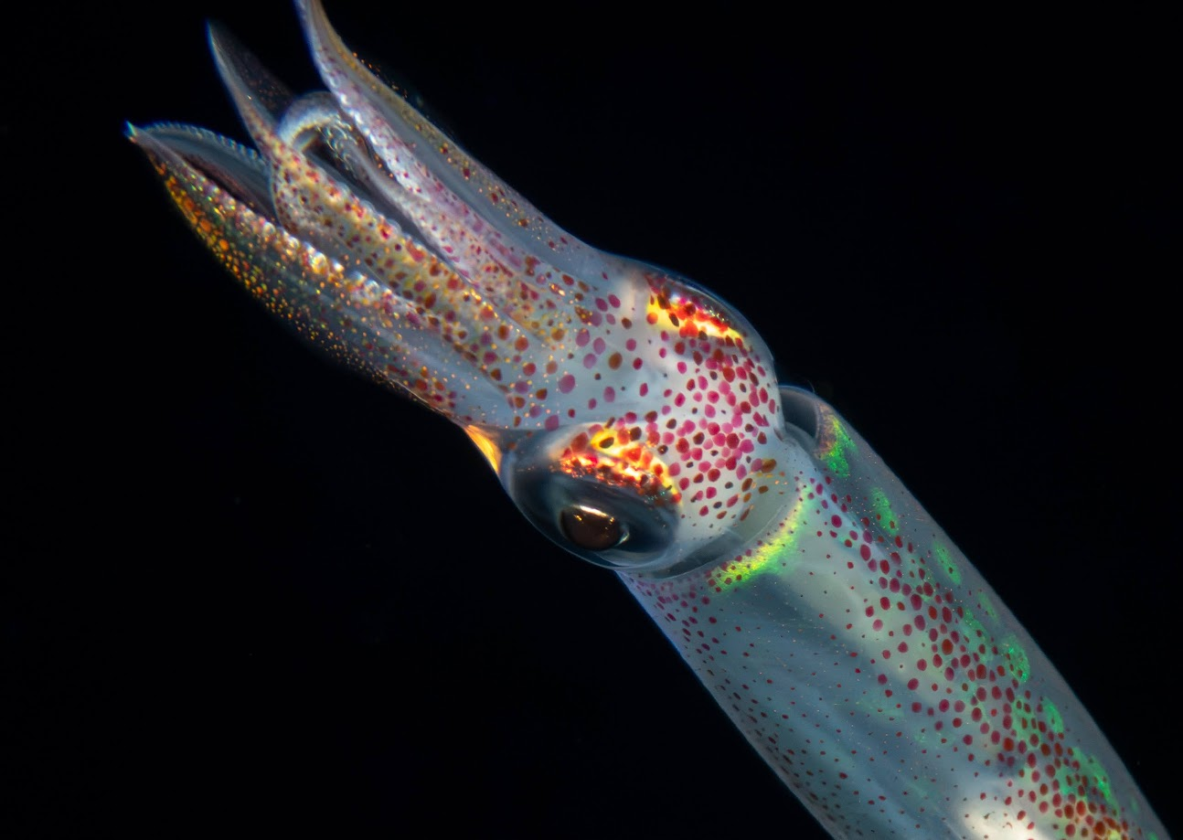
Liam Geyer –President
Year: Senior/IUG M.S. in Cyber
Major: Cybersecurity Analytics and Operations
Interests: Offensive security, SCUBA, metal music
Fun Fact: I’m a dive professional, and love underwater photography

Slide 5
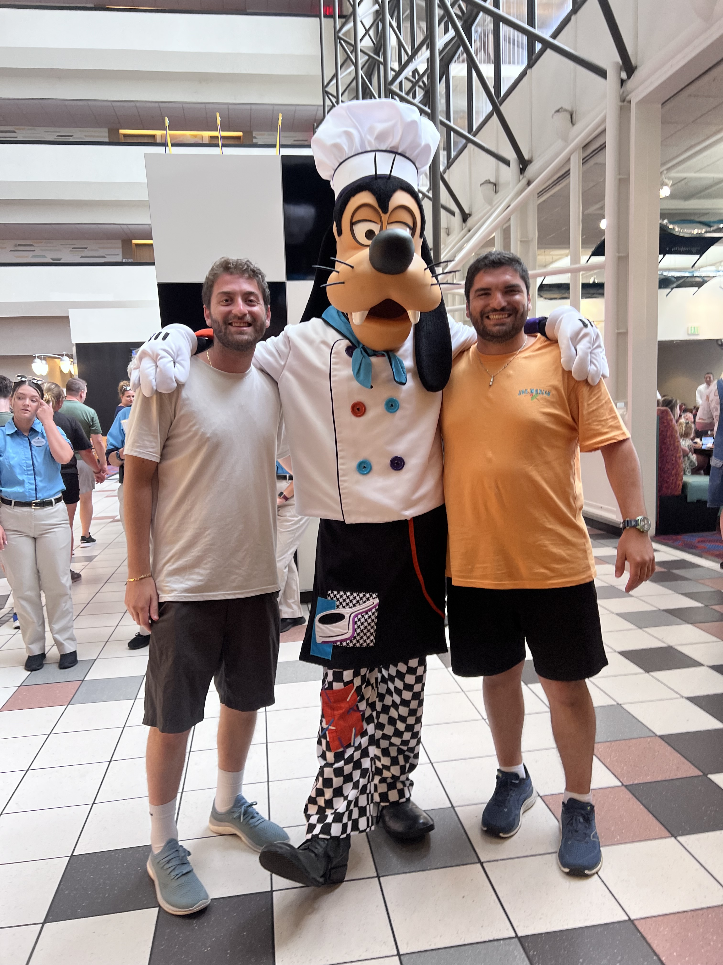
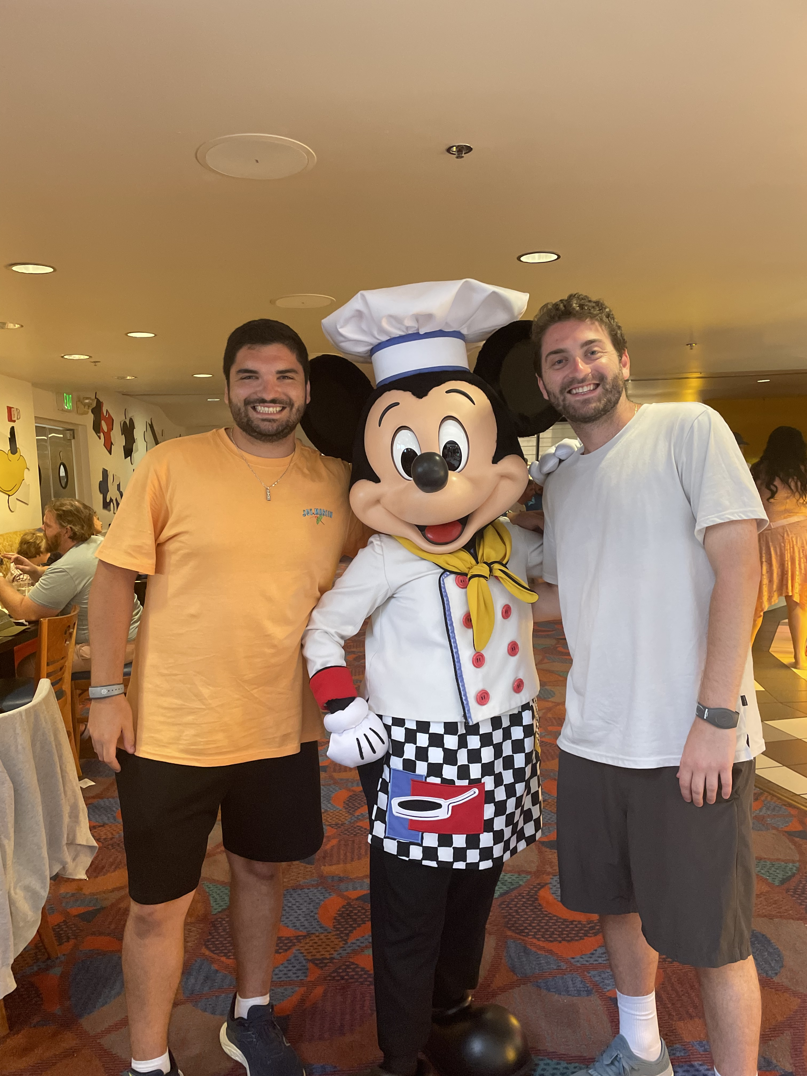
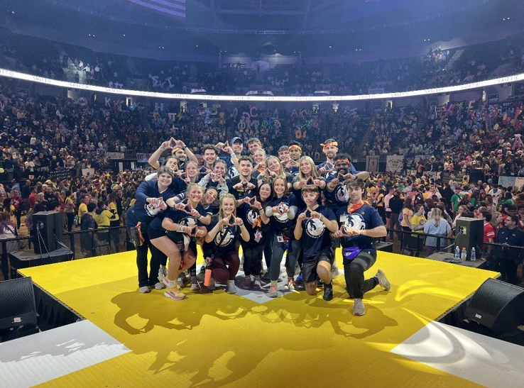
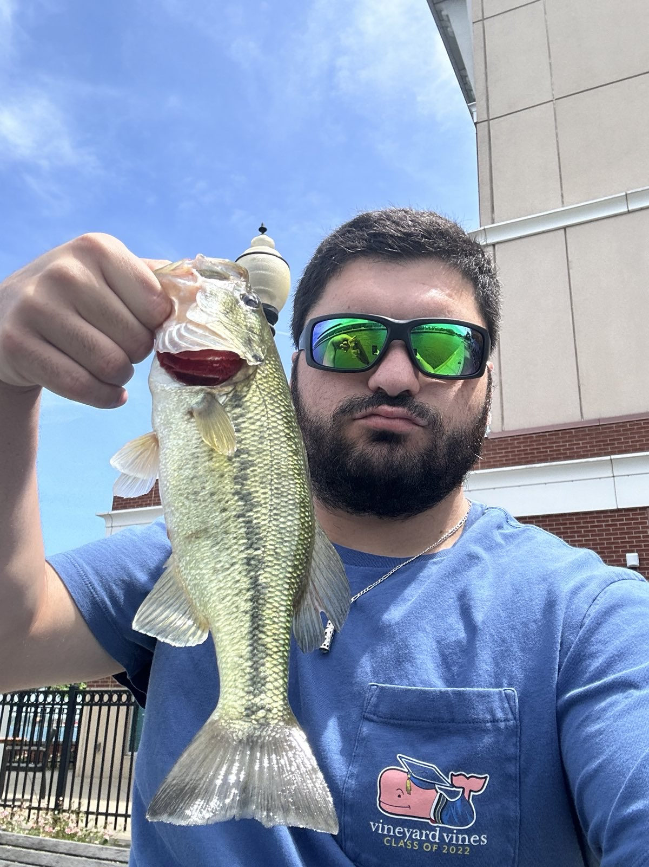
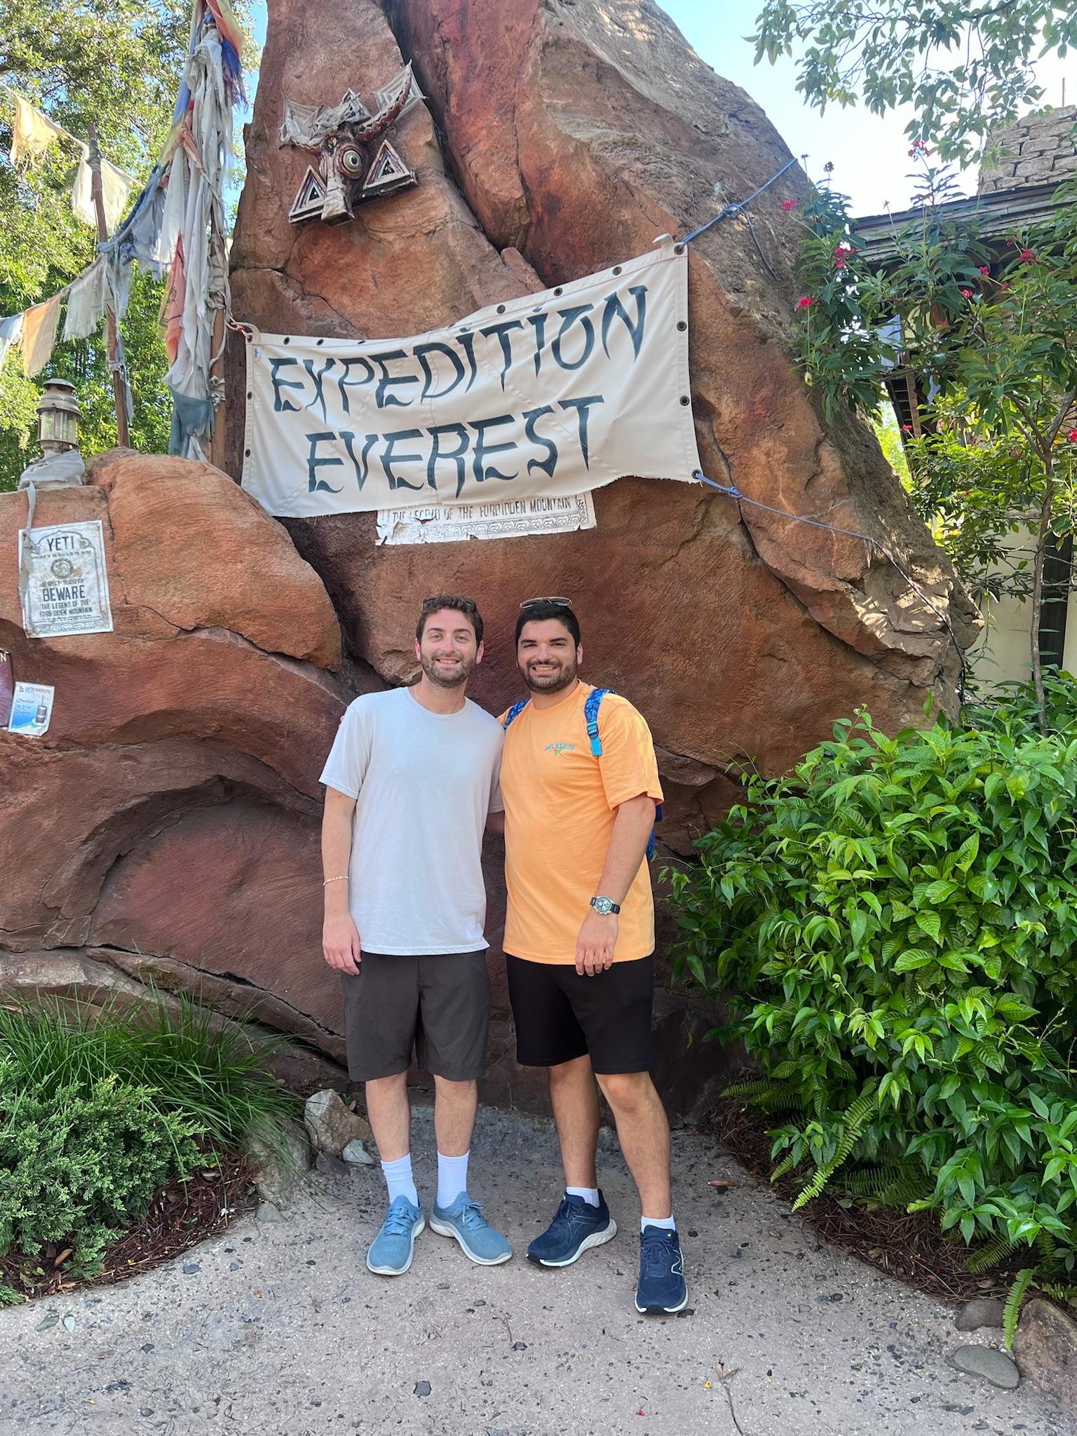
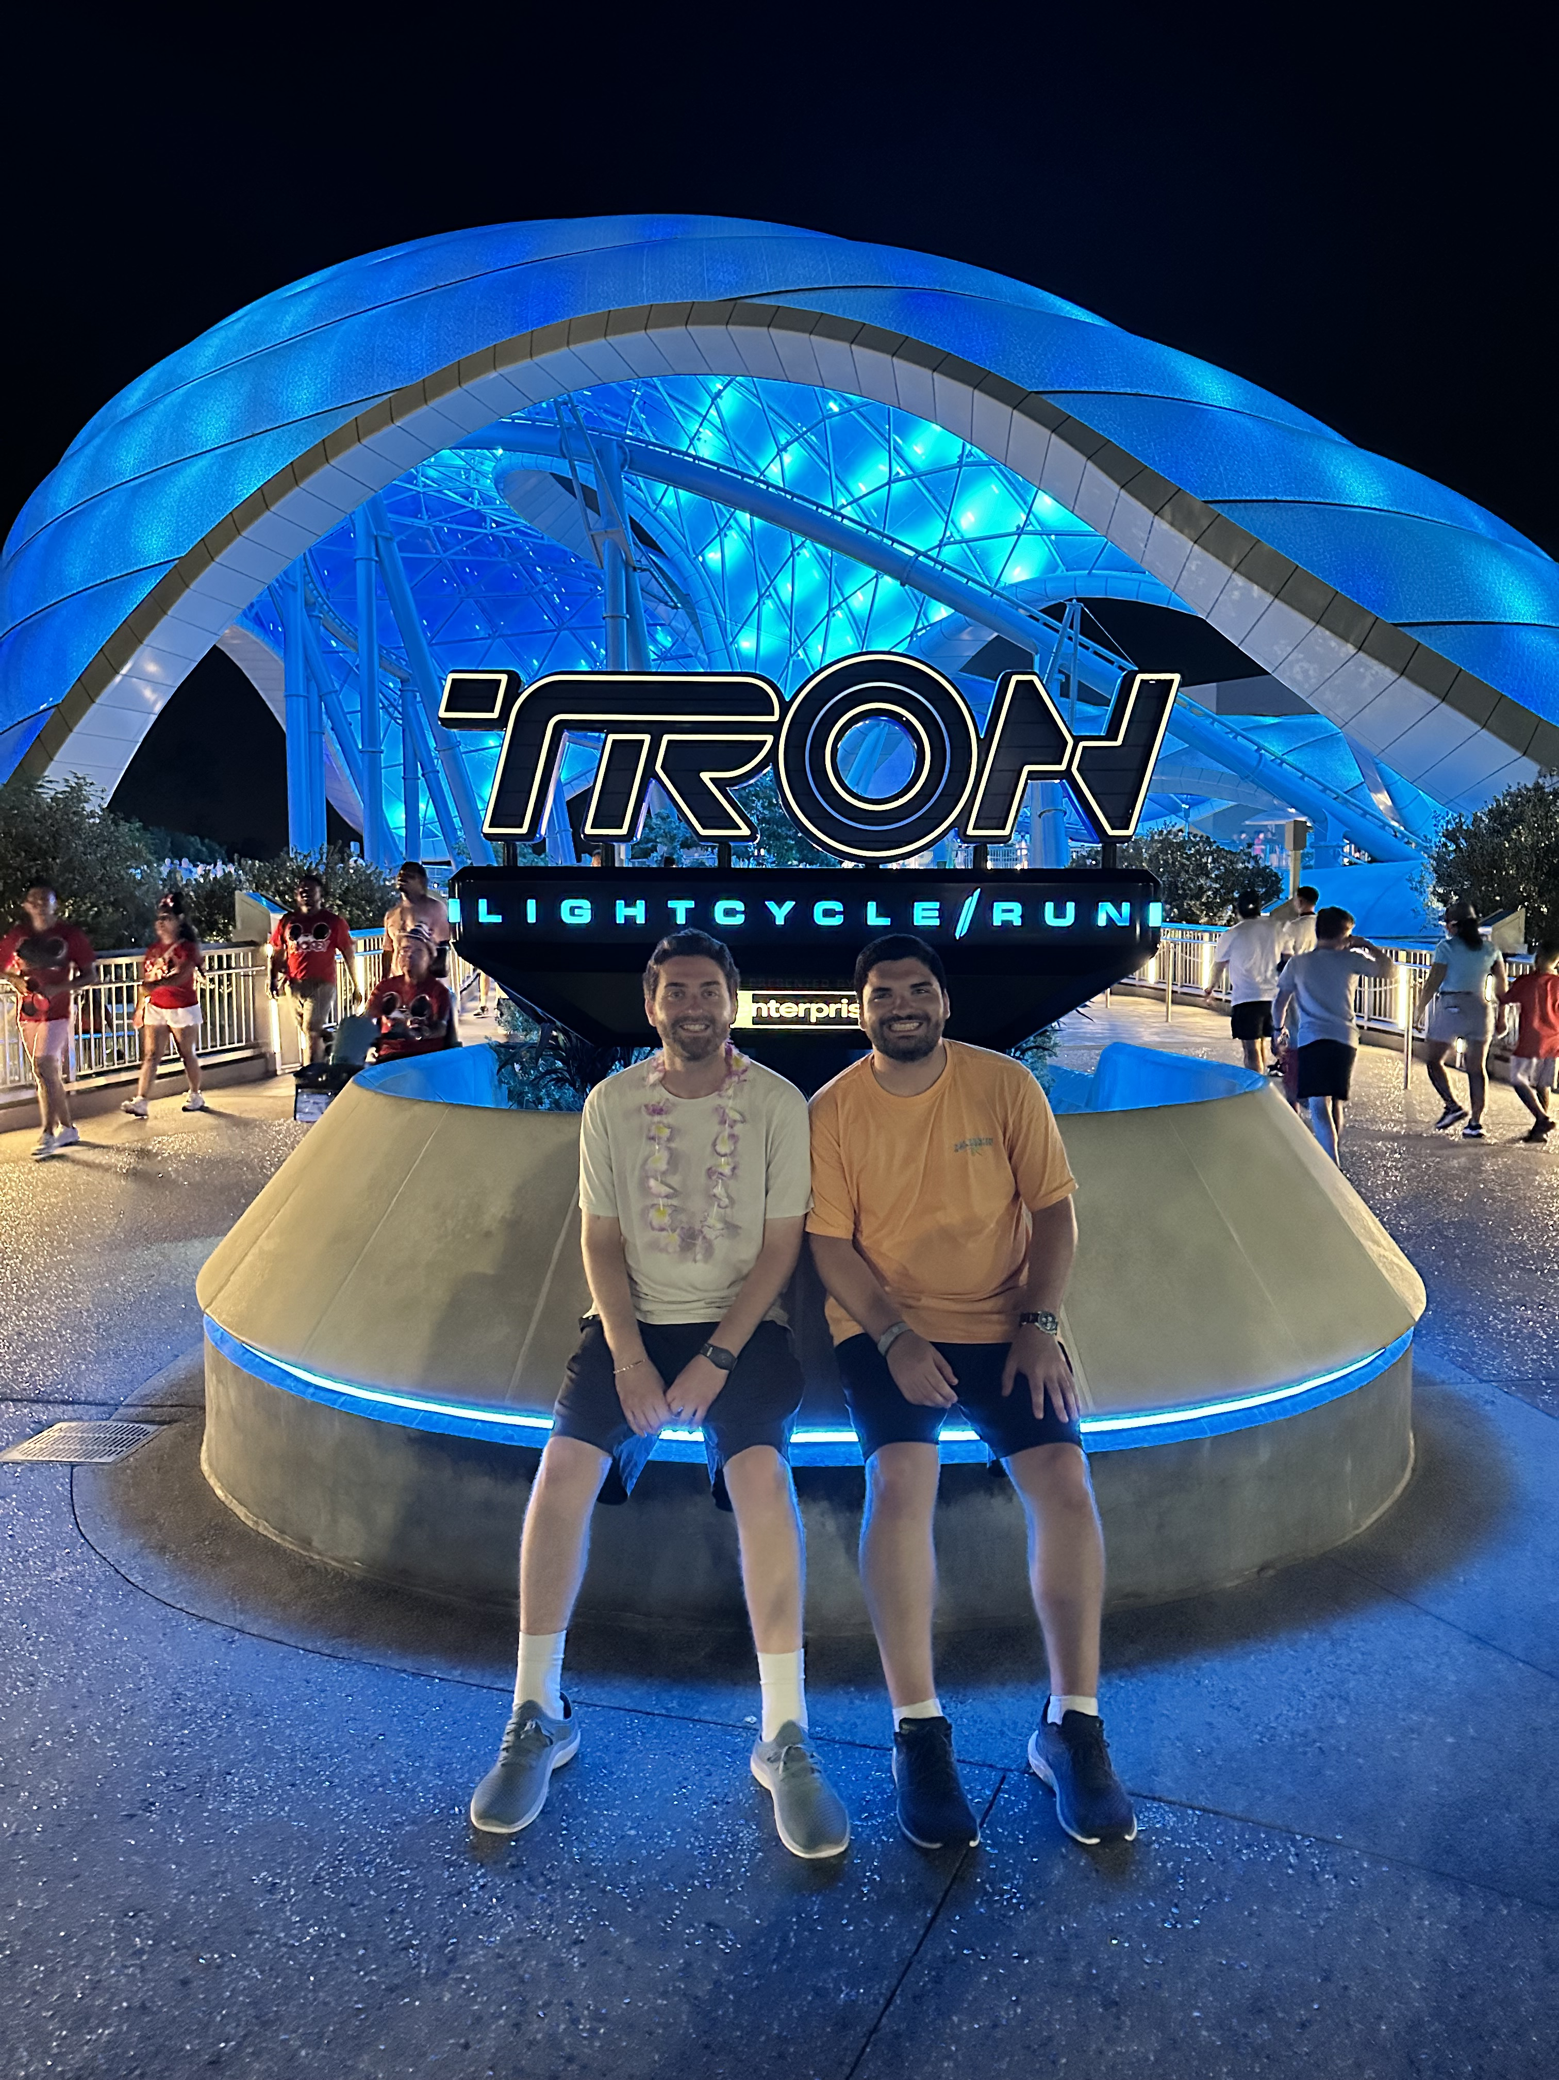
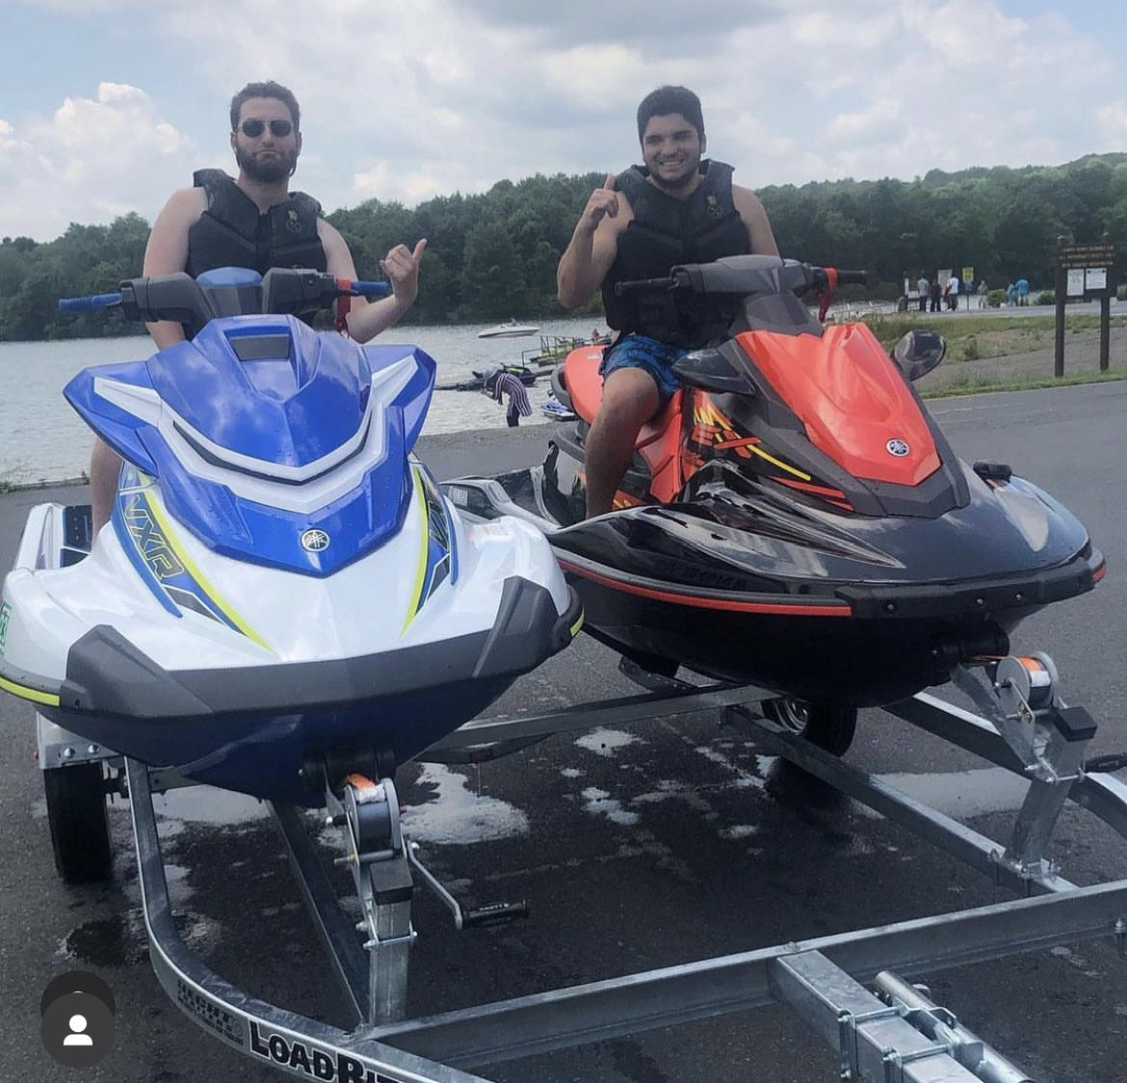
Evan Glickman – Vice President
Year: Junior
Major: Cybersecurity Analytics and Operations
Interests: Fishing, Outside, BBQ, Disney
Fun Fact: I love Disney

Slide 6
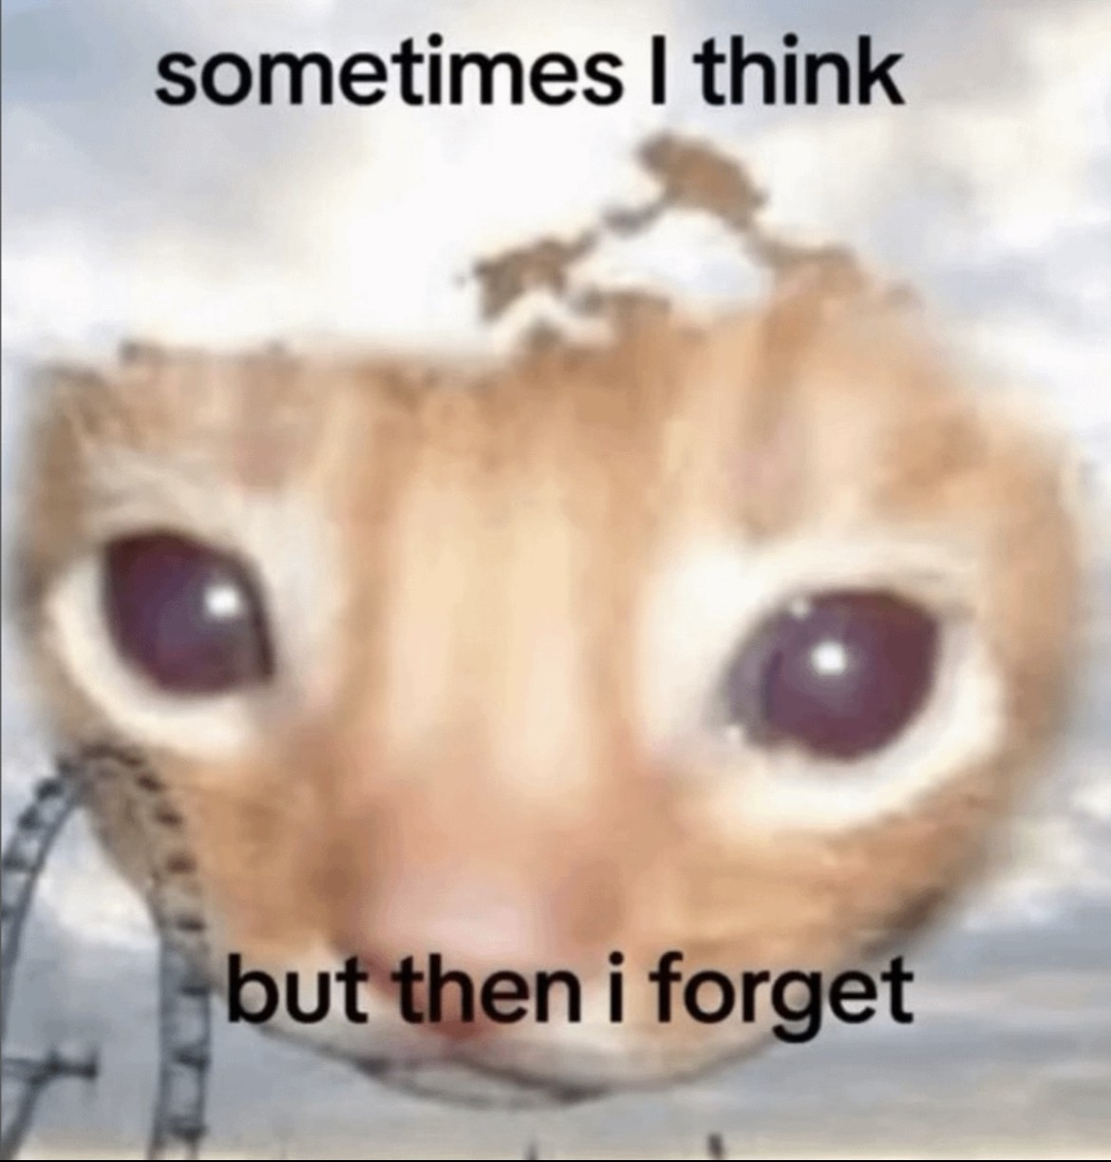
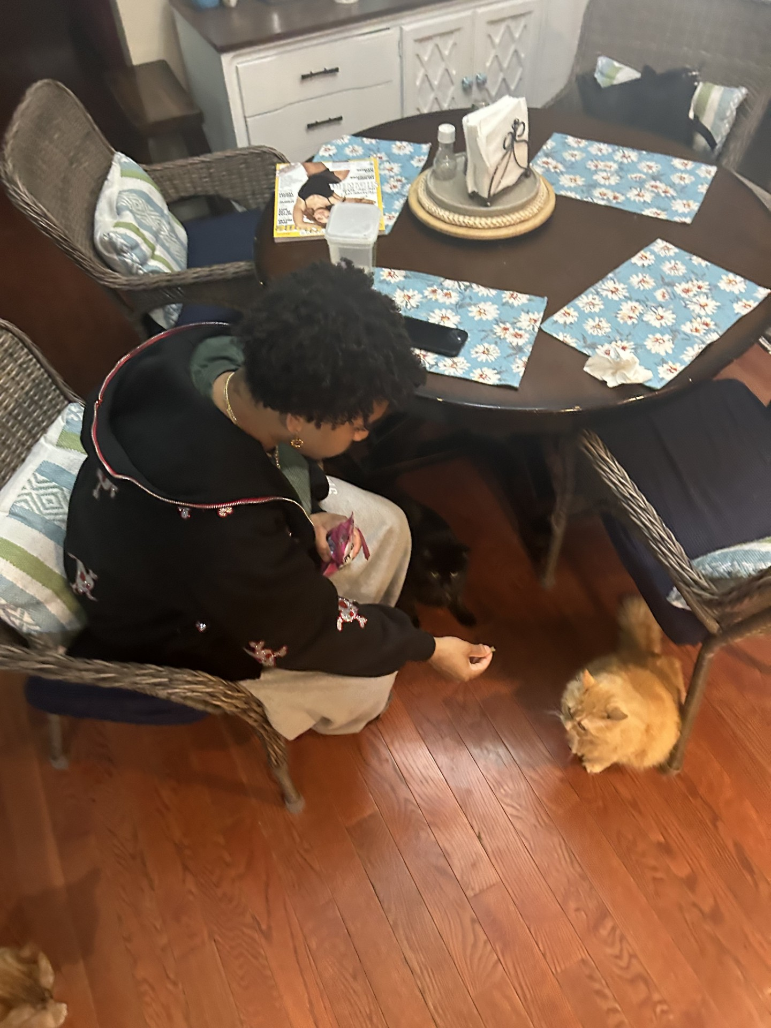

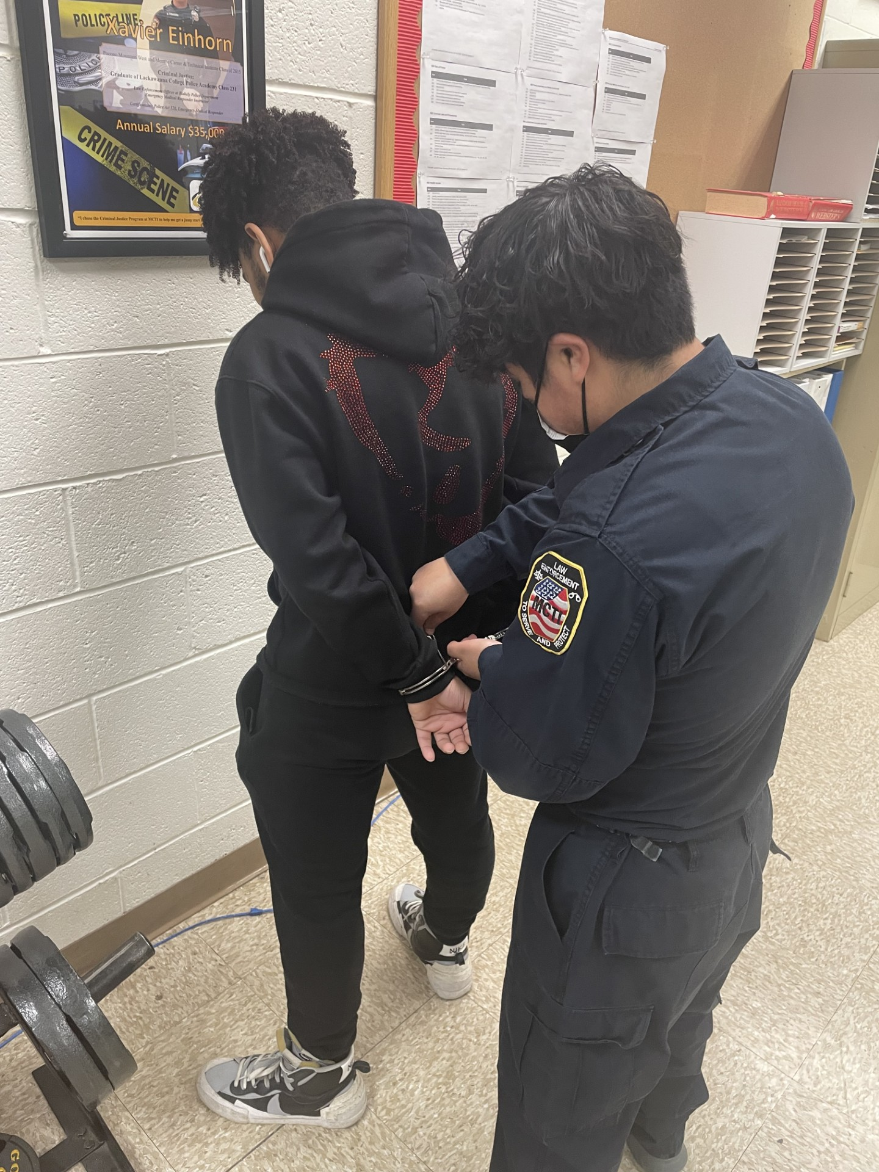
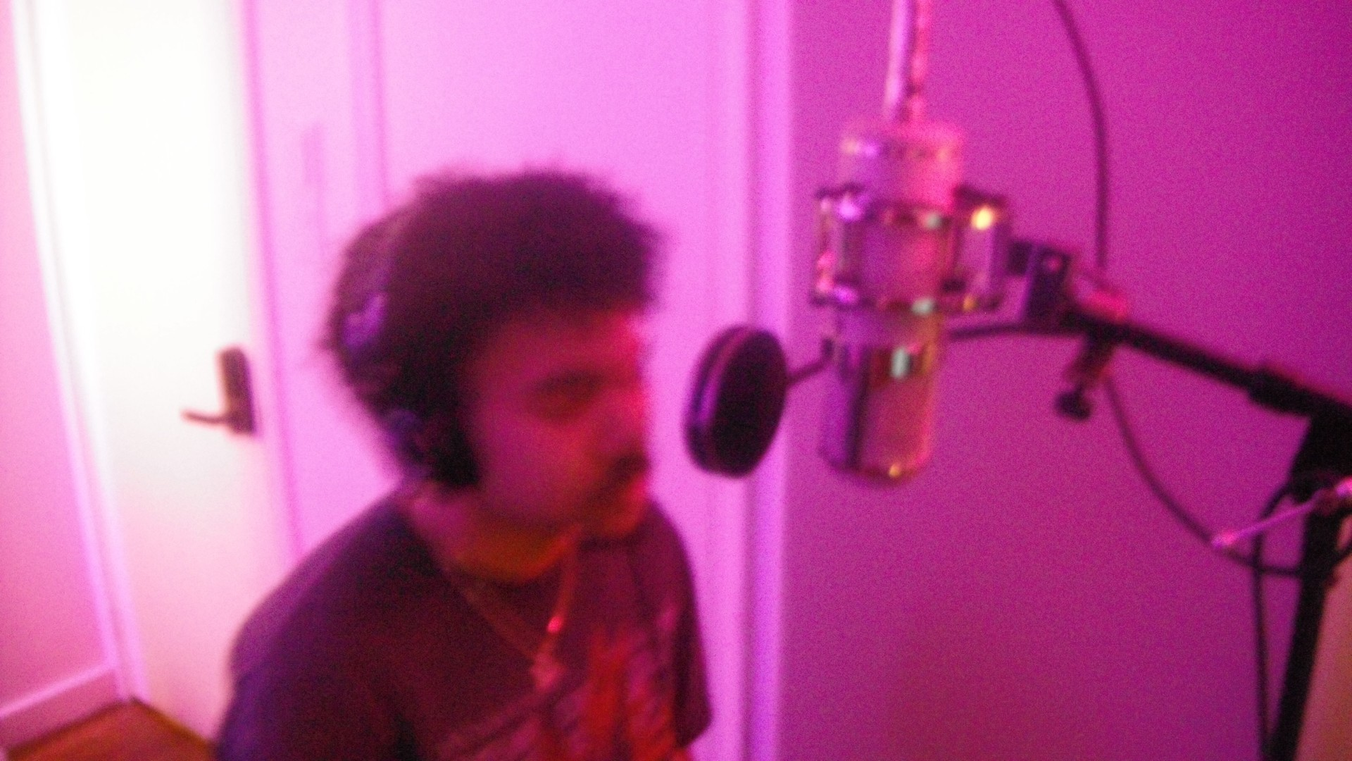
Jonathan Skeete – Red Team Captain
Year: Sophomore
Major: Cybersecurity Analytics and Operations
Interests: Cats, Hacking?, Music, Travelling
Fun Fact: i nono wanna :(

Slide 7
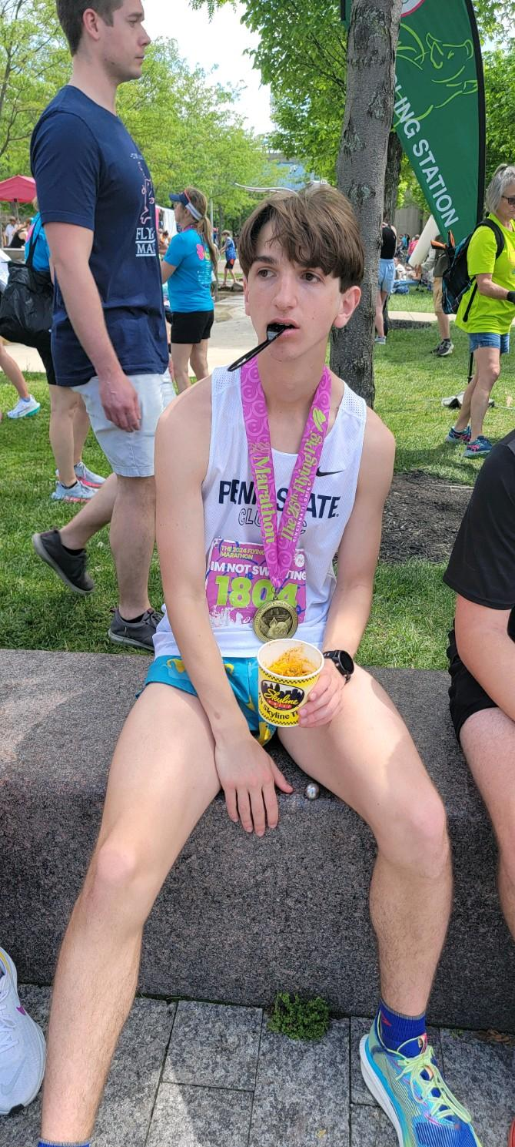
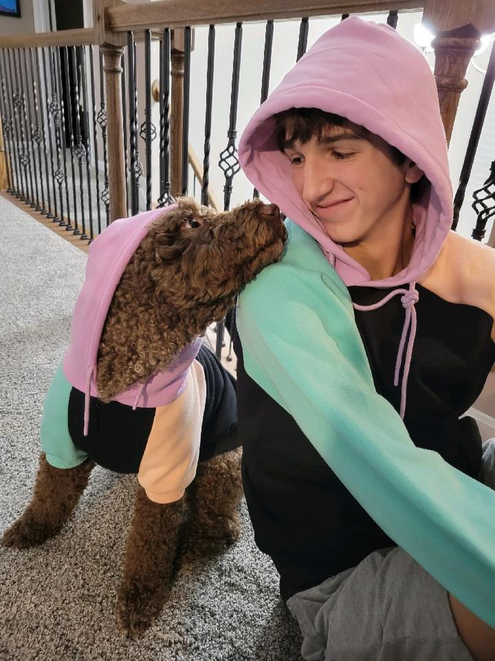
Aidan Ethier – Defensive Captain
Year: Sophomore
Major: Cybersecurity Analytics and Operations
Interests: Running, Reading
Fun Fact: I ran a marathon

Slide 8
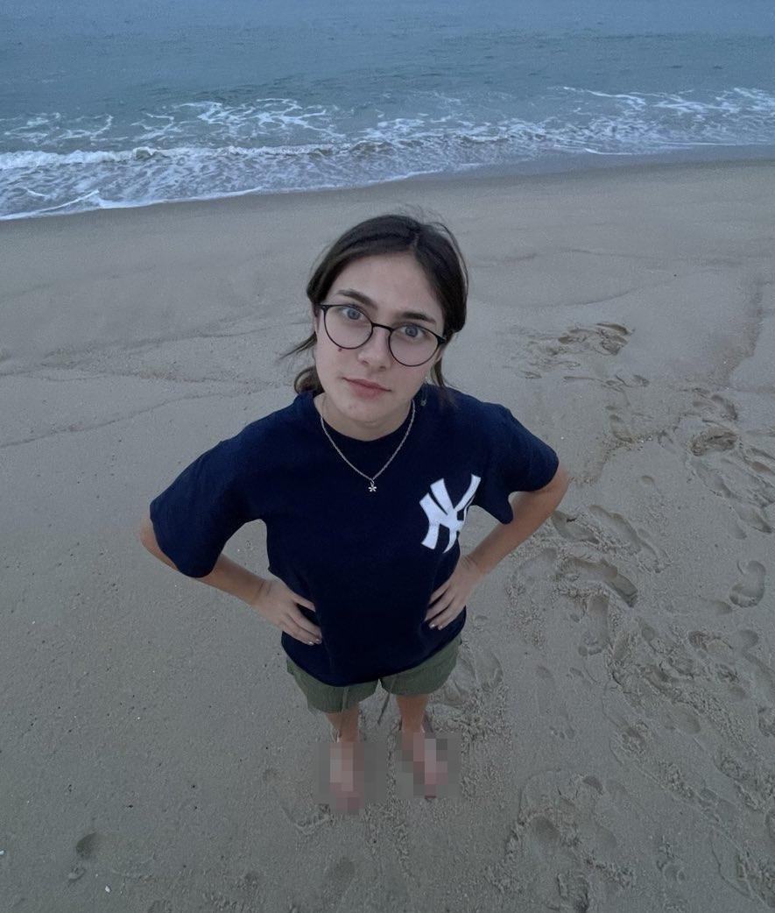
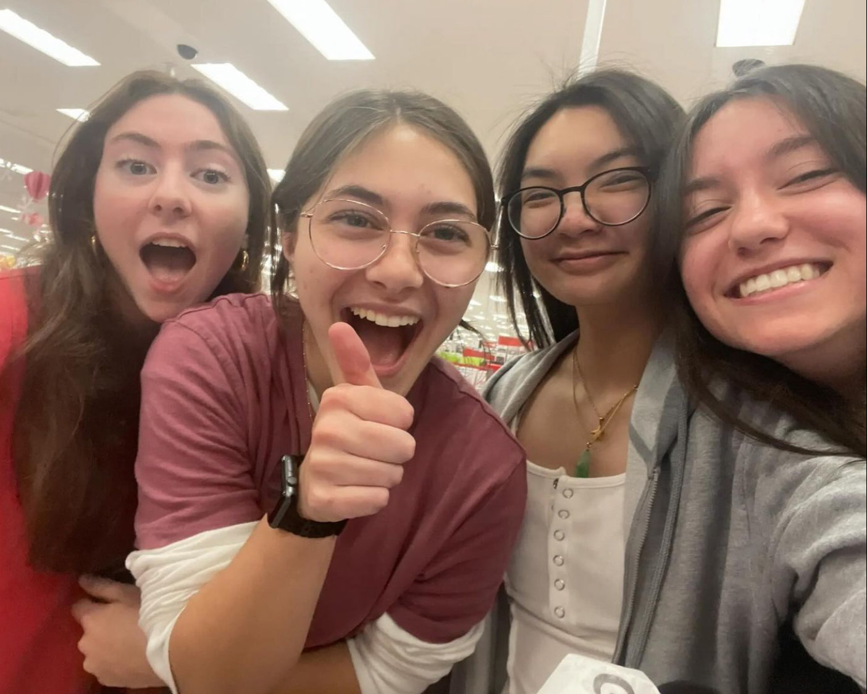
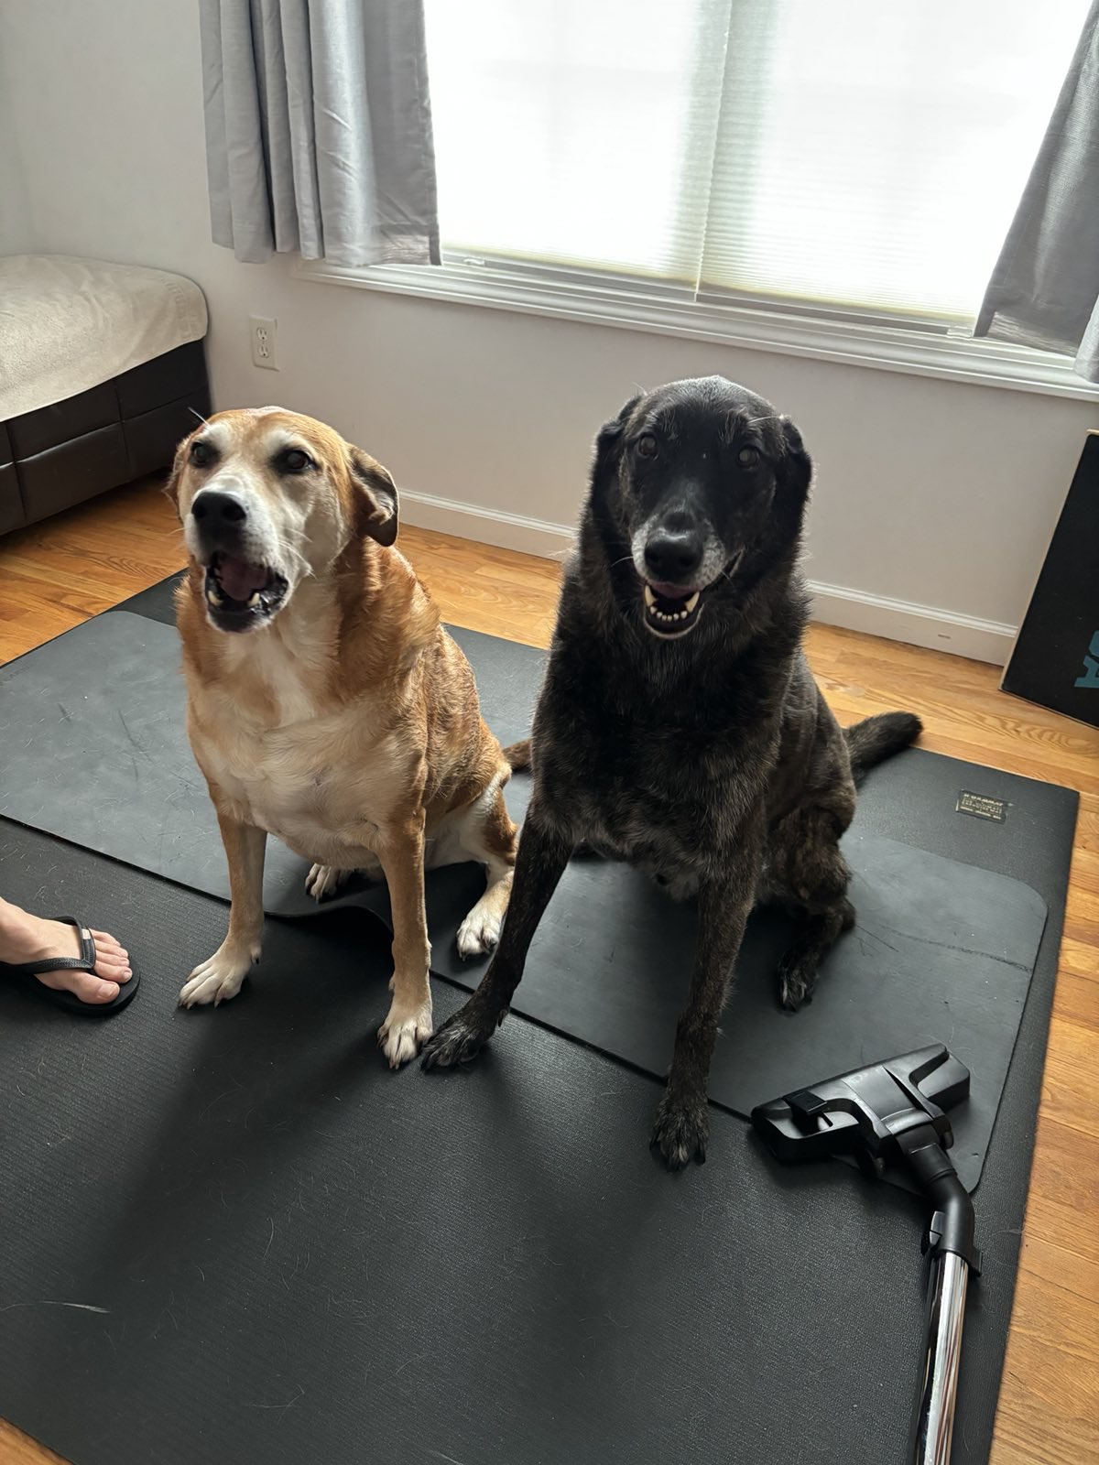
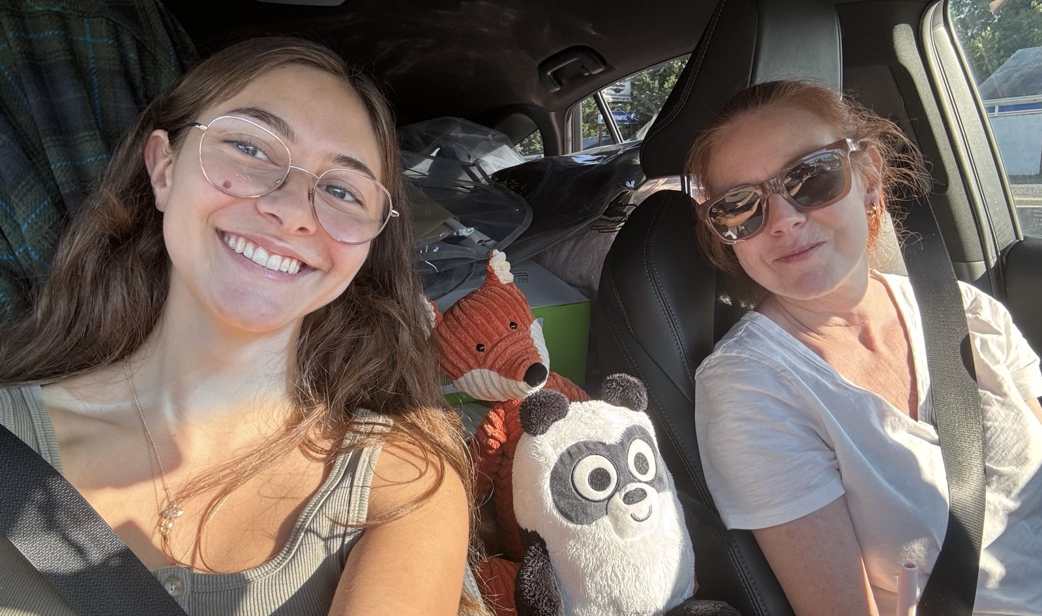
Isabella Masso - Treasurer
Year: Sophomore
Major: Cybersecurity Analytics and Operations
Interests: giving unsolicited music recs, reading, crochet
Fun Fact: i luv deftones!

Slide 9
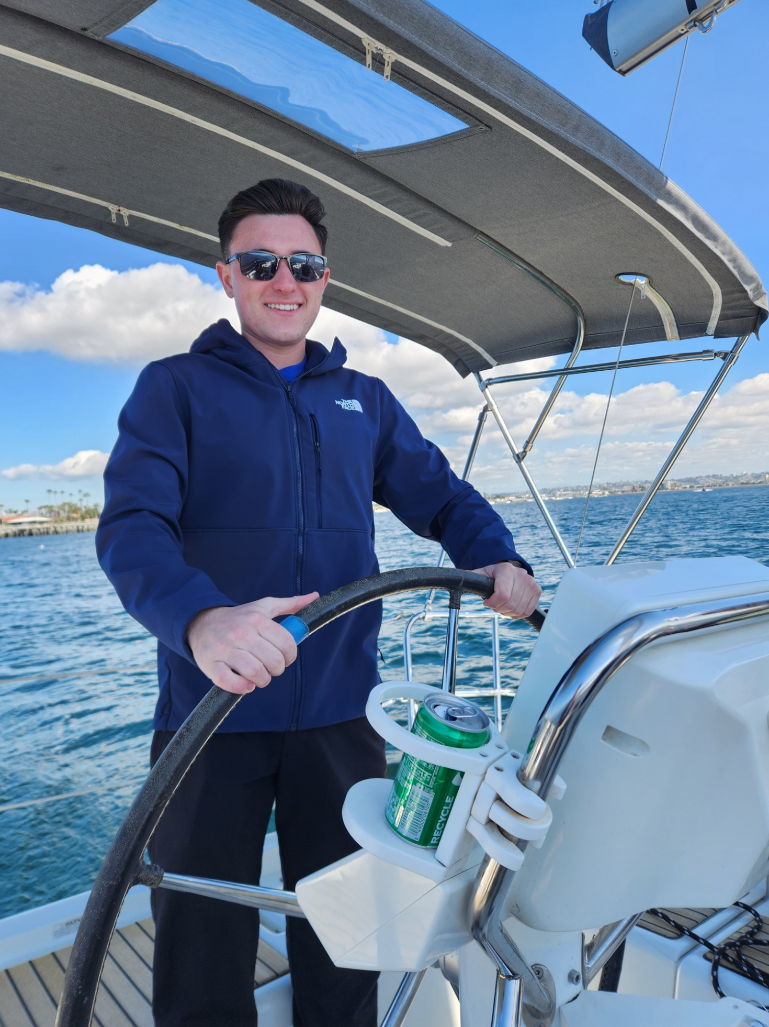
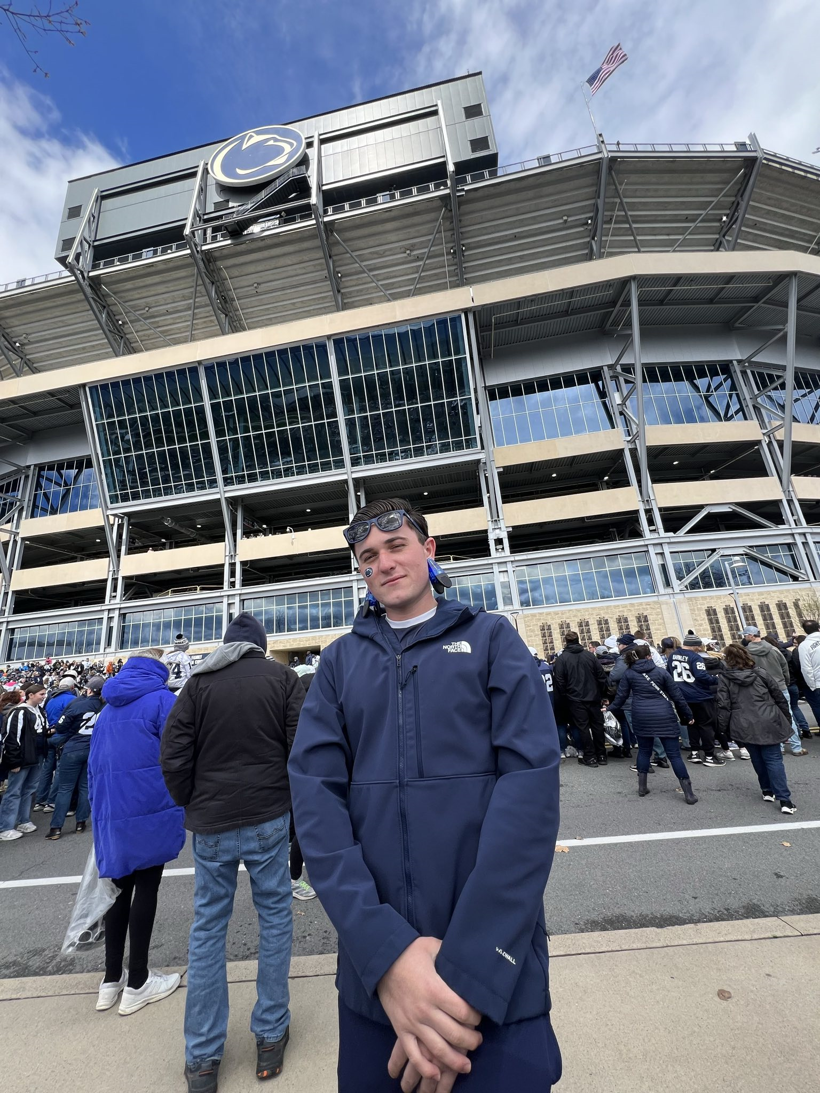
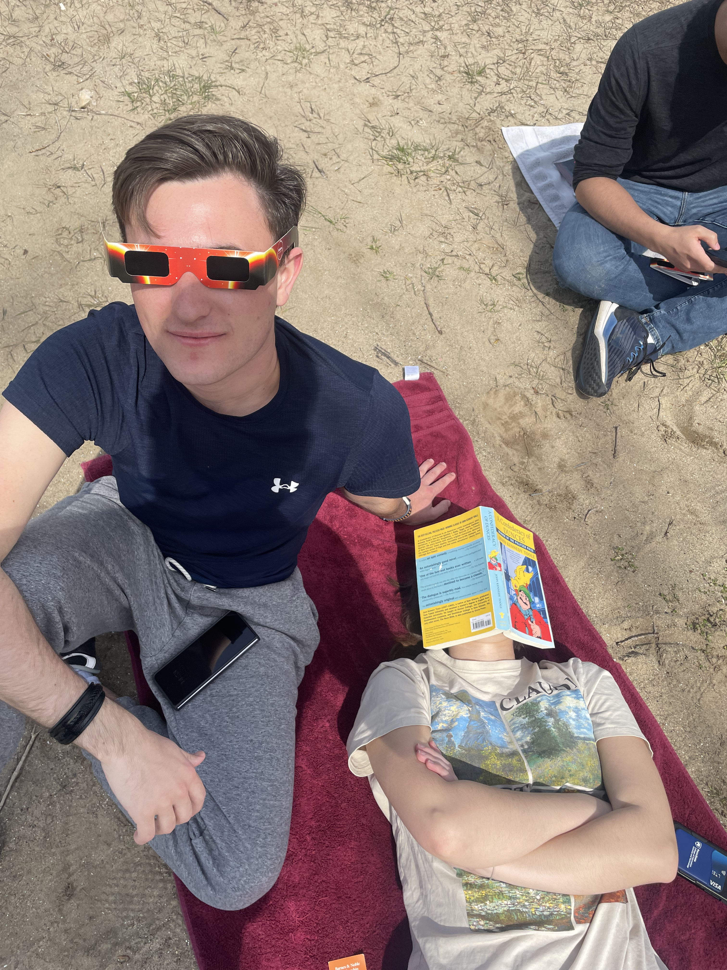
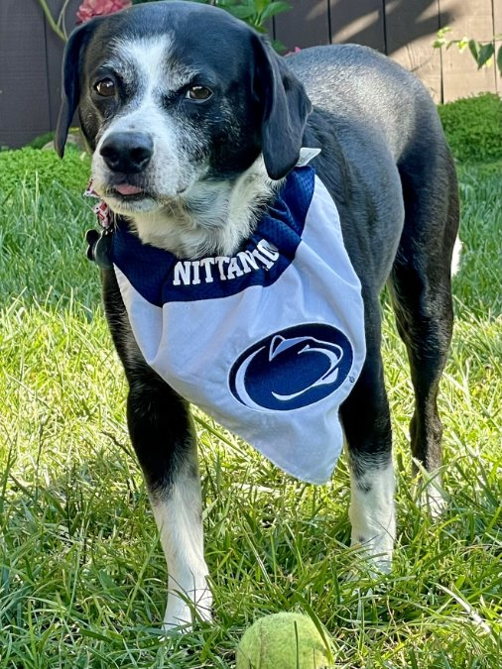
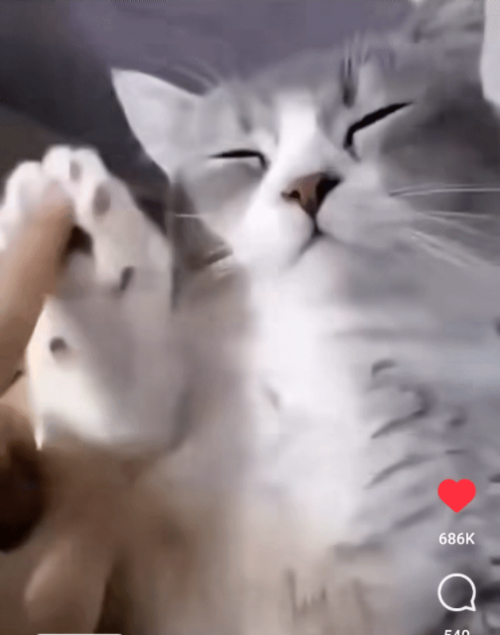

Aiden Johnson – Tech Director
Year: Sophomore
Major: Computer Science
Interests: Sailing, hiking, Snowboarding
Fun Fact: From San Diego, CA
Designed & Developed by Aiden Johnson | TGM.One

Slide 10
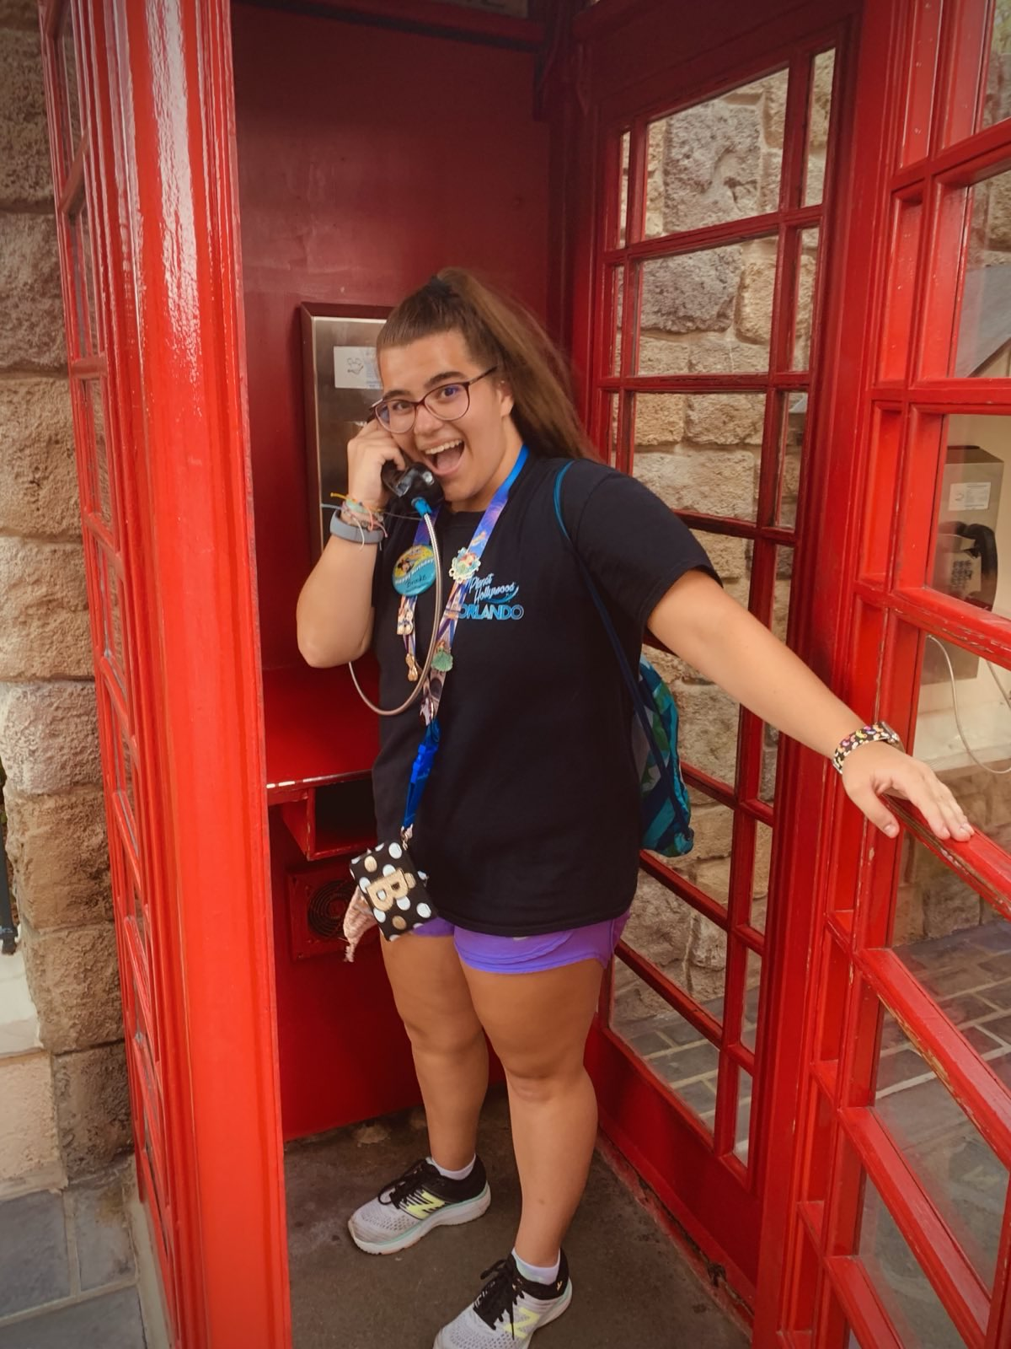
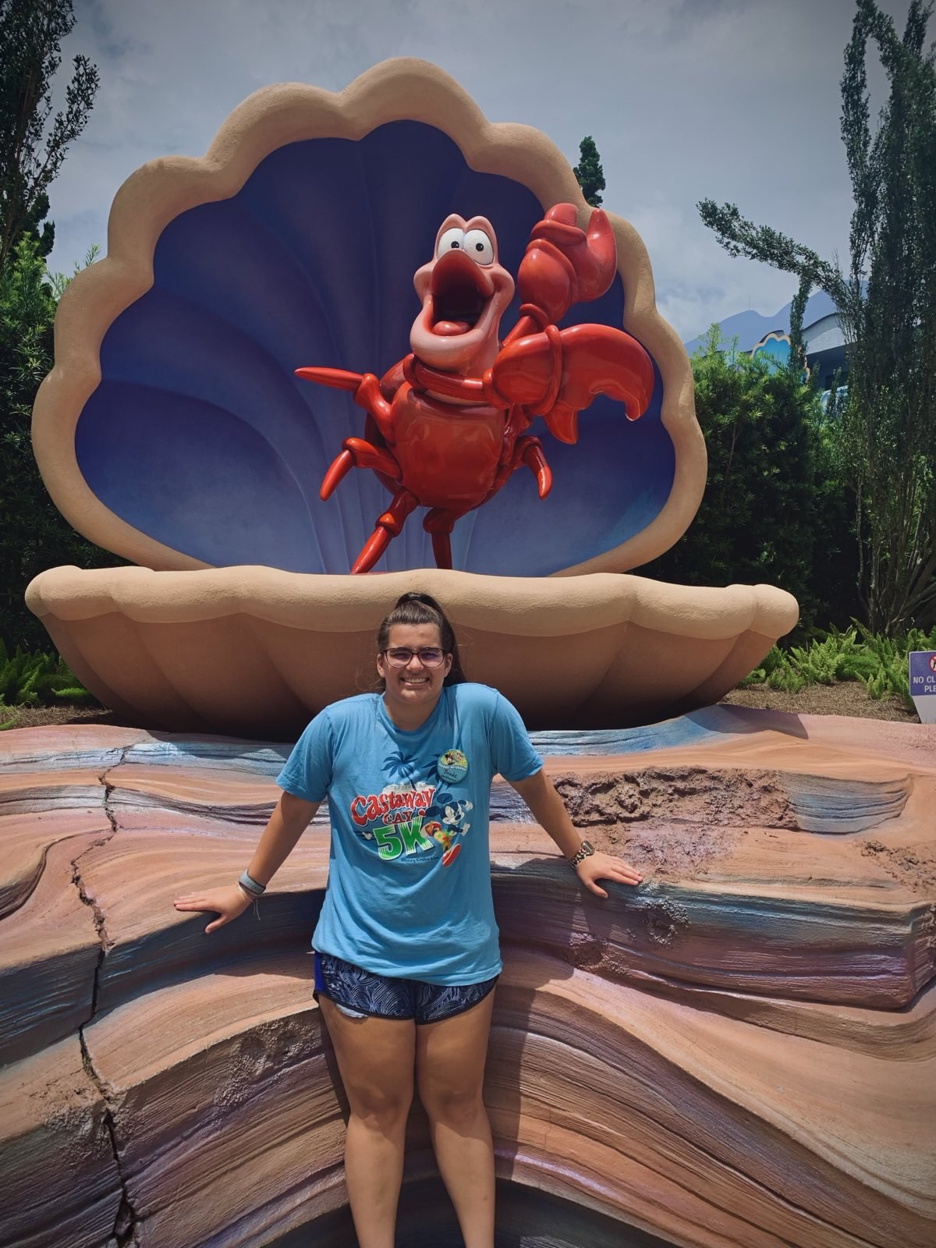
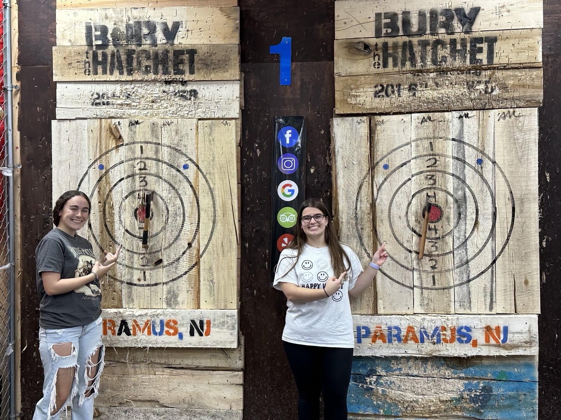
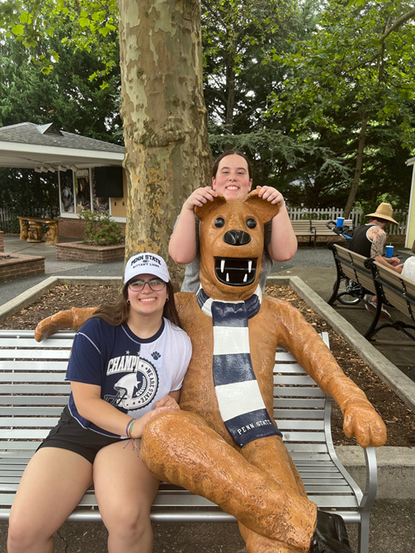
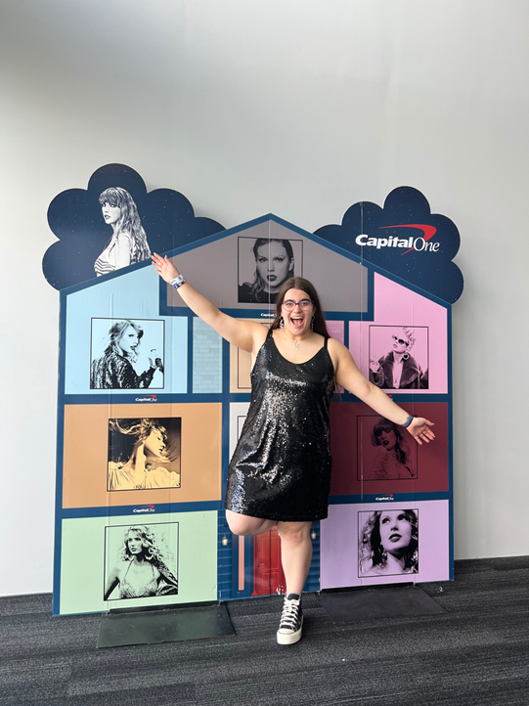
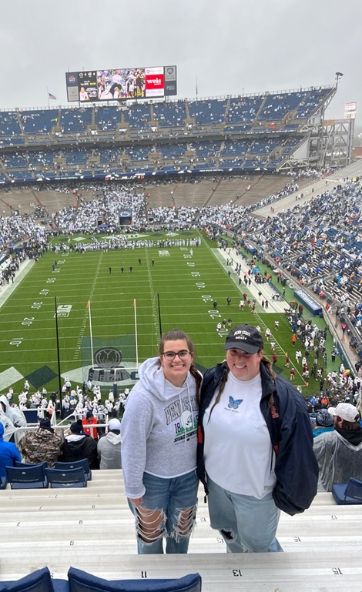
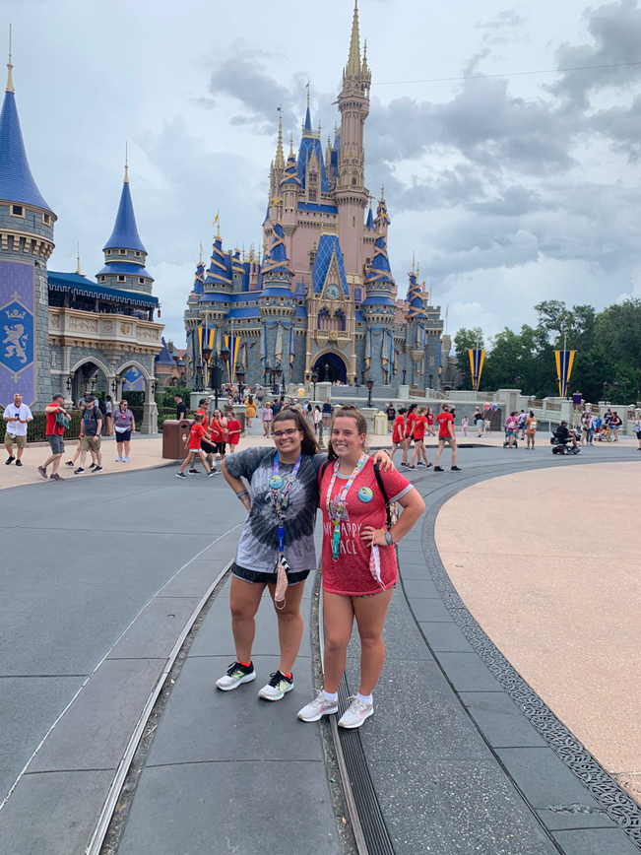
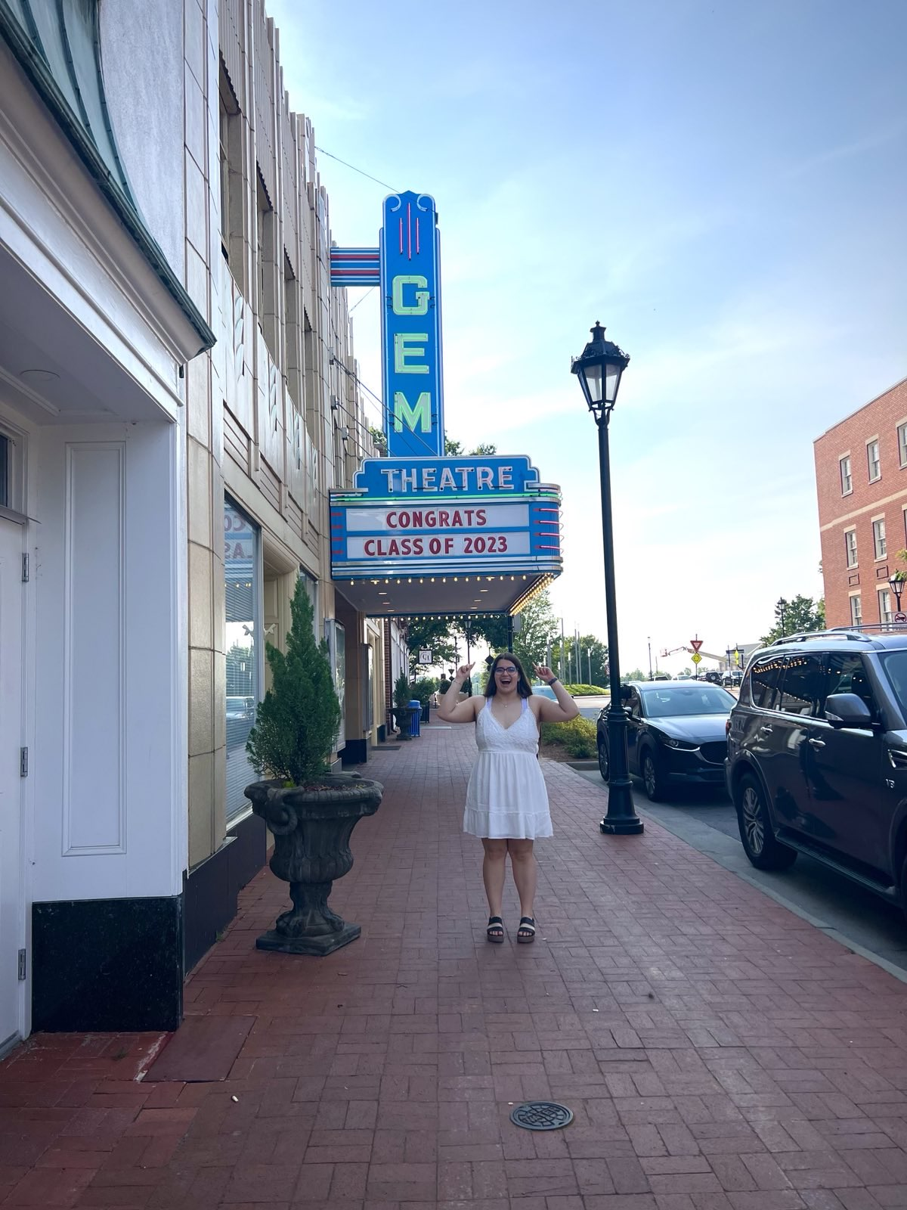
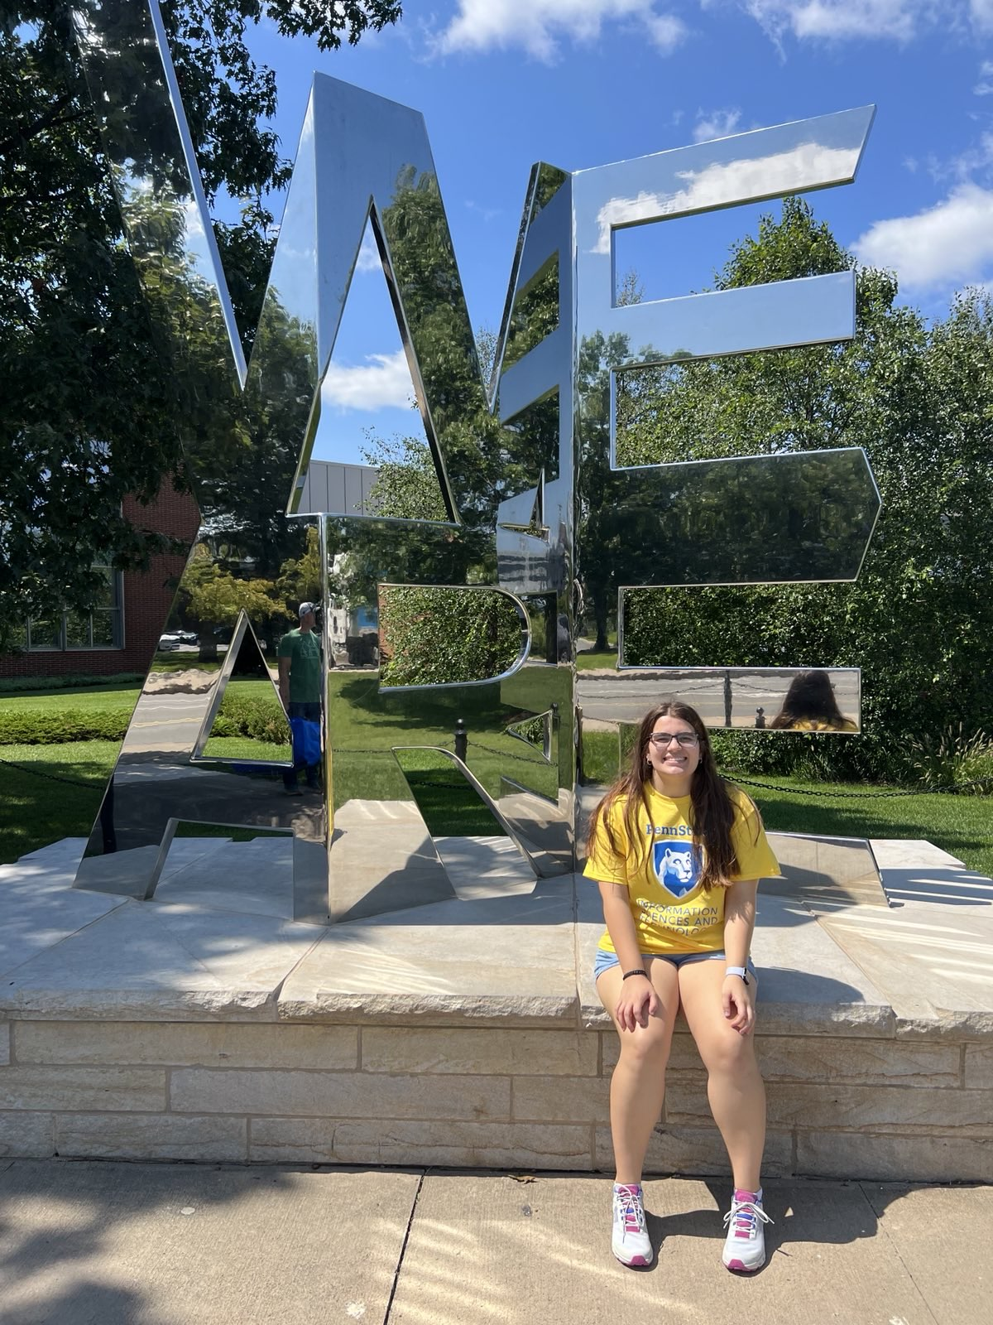
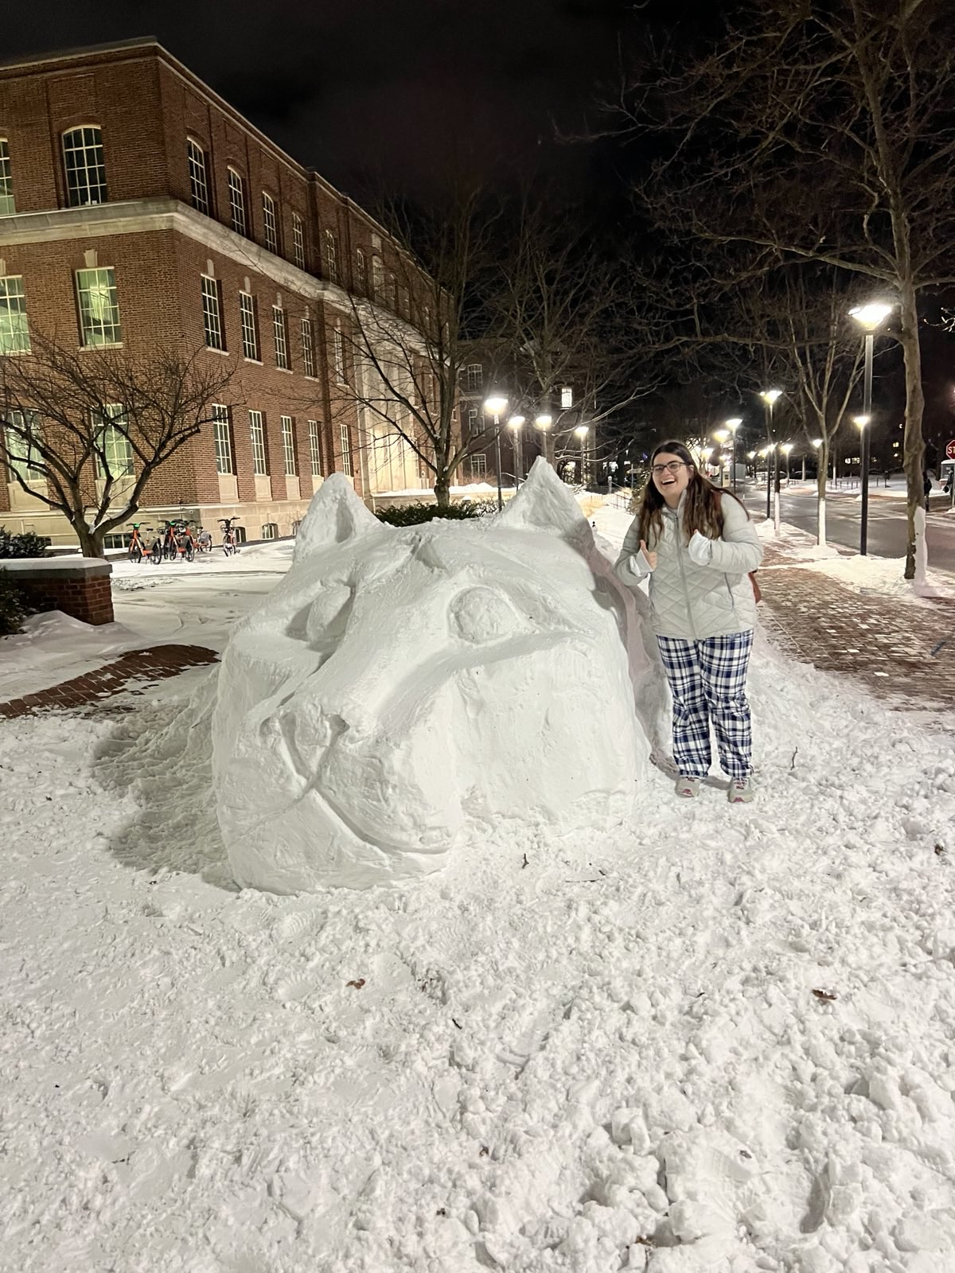
Brooke Connelly - Secretary
Year: Sophomore
Major: Cybersecurity Analytics and Operations
Interests: Swimming, Biking, Photography
Fun Fact: I spent my summer in Houston!

Slide 11
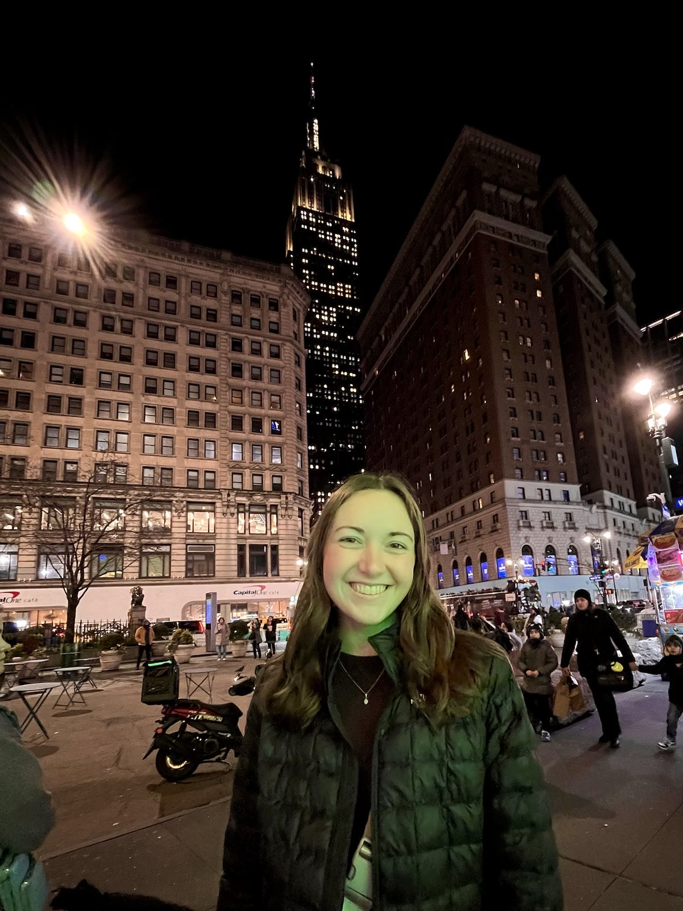
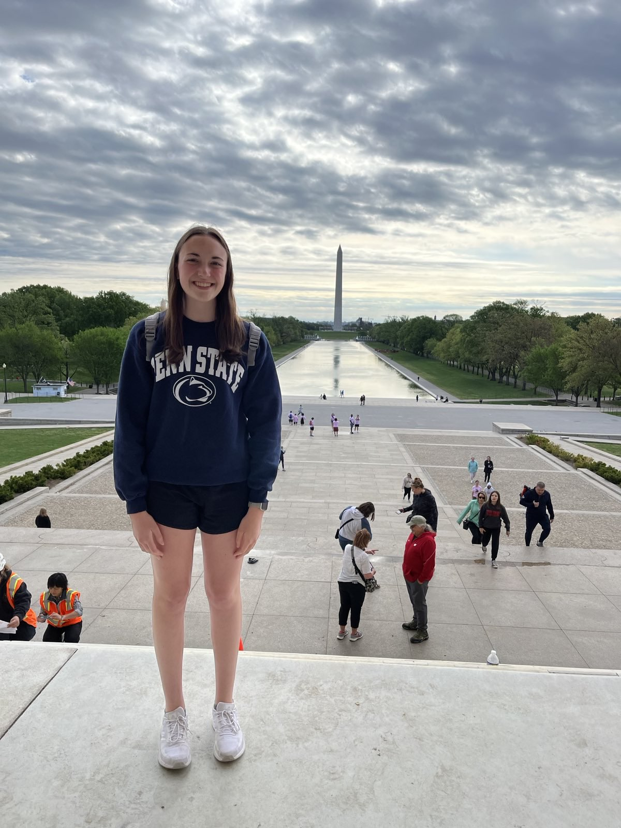
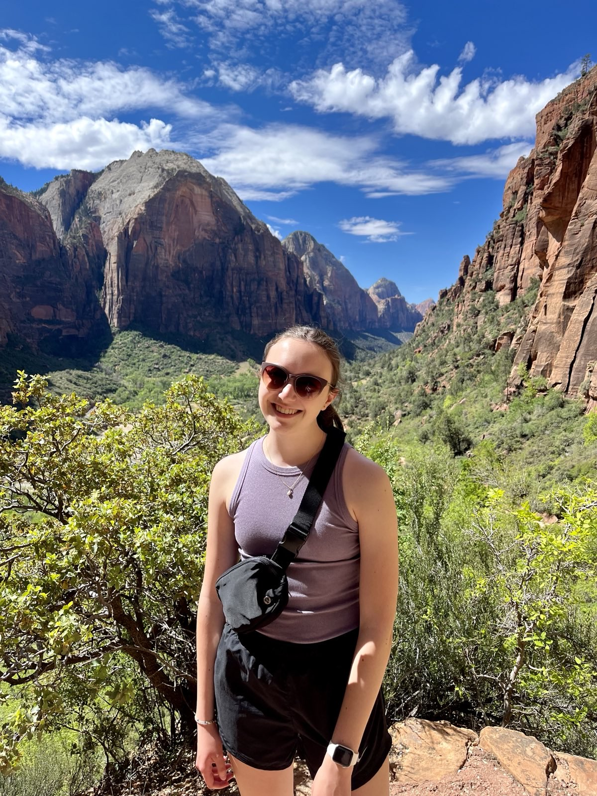
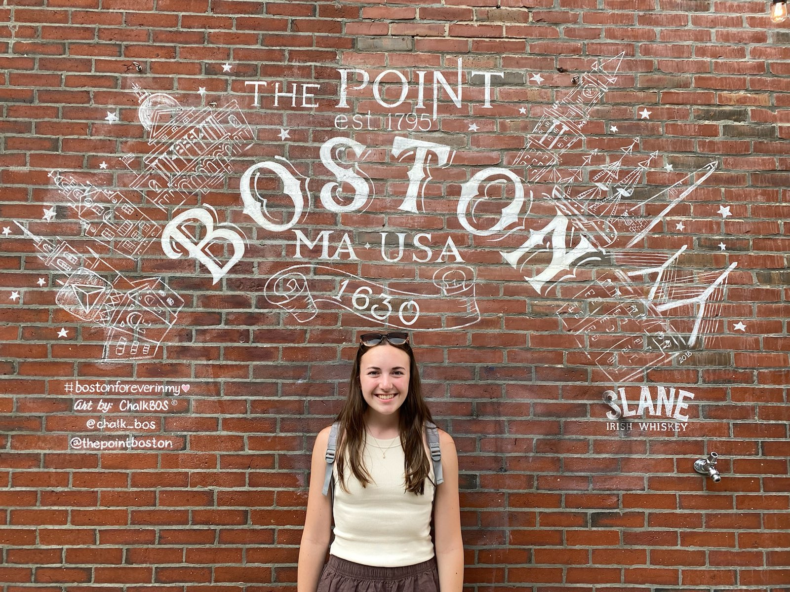
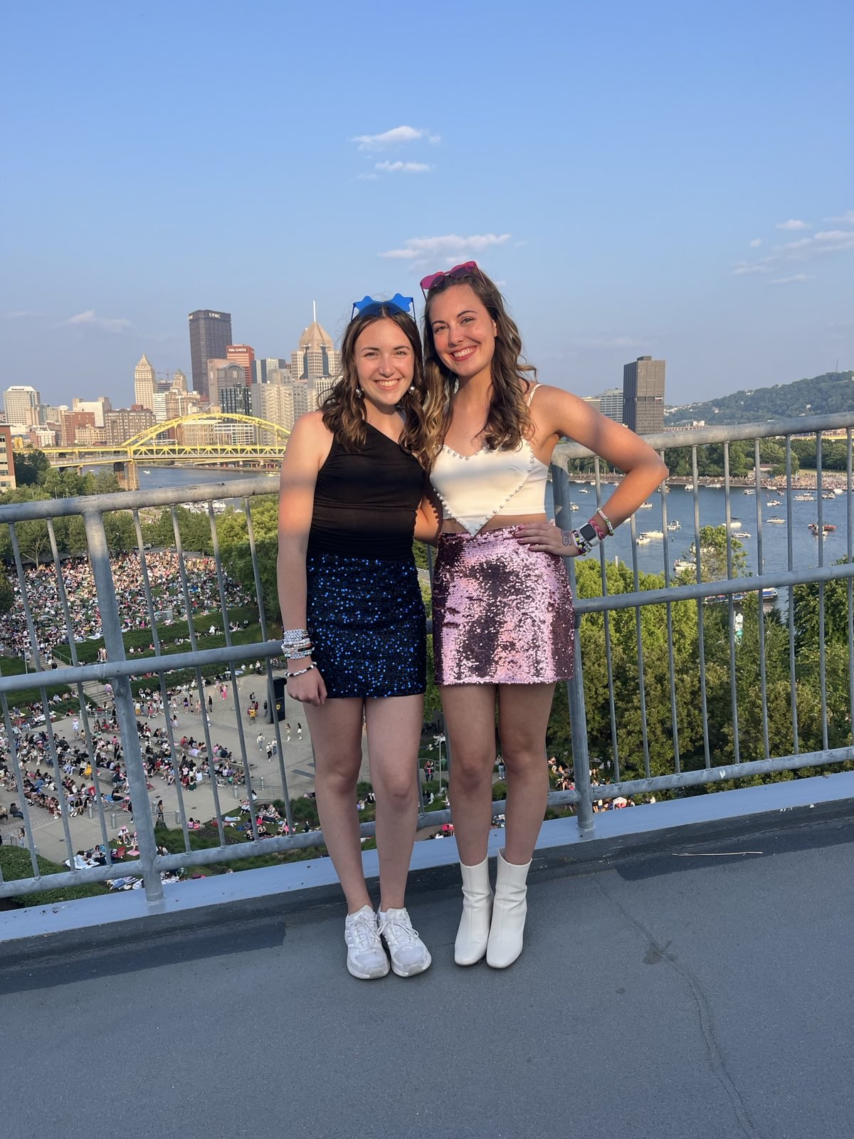
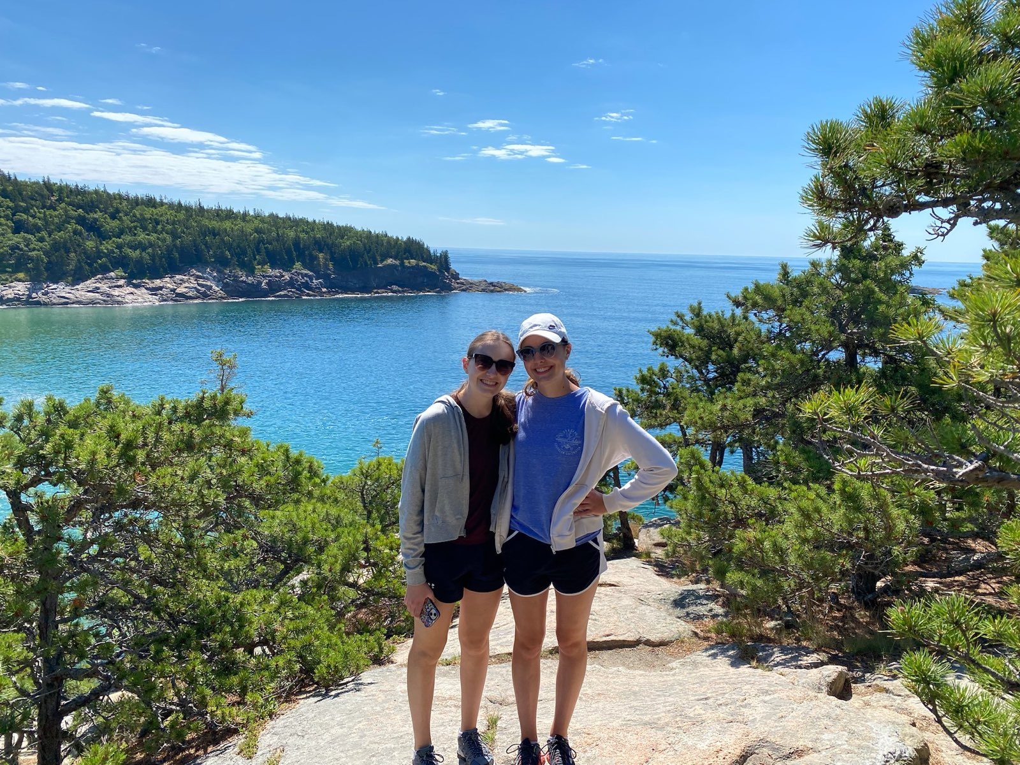
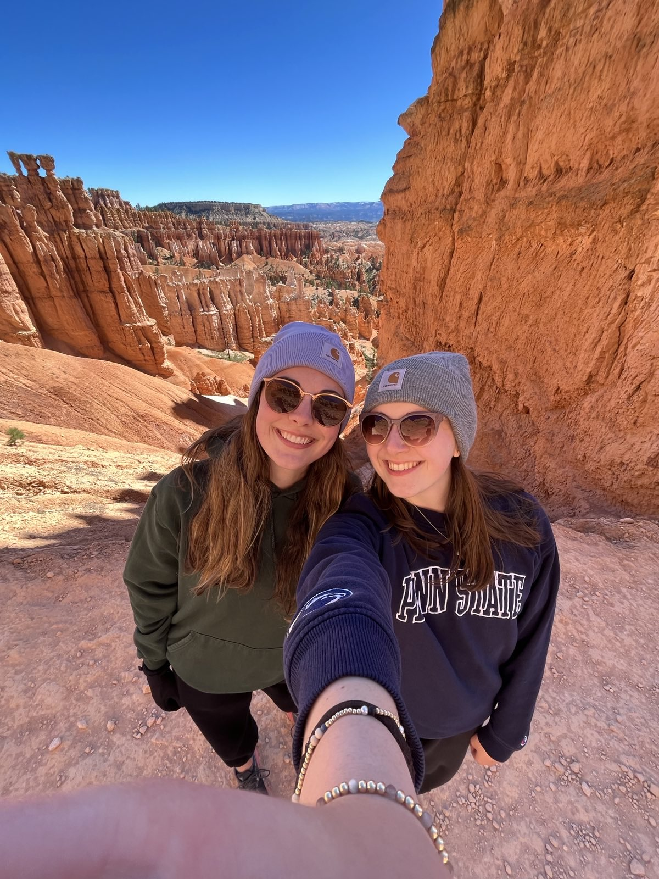
Bailey Milanovich – Event Planner
Year: Sophomore
Major: Cybersecurity Analytics and Operations
Interests: Listening to music (pop, folk, country), traveling, hiking, going to coffee shops
Fun Fact: I’m missing this meeting because I’m at a Kacy Musgraves Concert!

Slide 12
Captains & Chairs
Mike Catelli – Competition Chair
Asa Reynolds – Content Dev. Chair
Evan Reigner – Social & Recruitment Chair
Cy Fisher - Webmaster
Notes:
Jenna

Slide 13
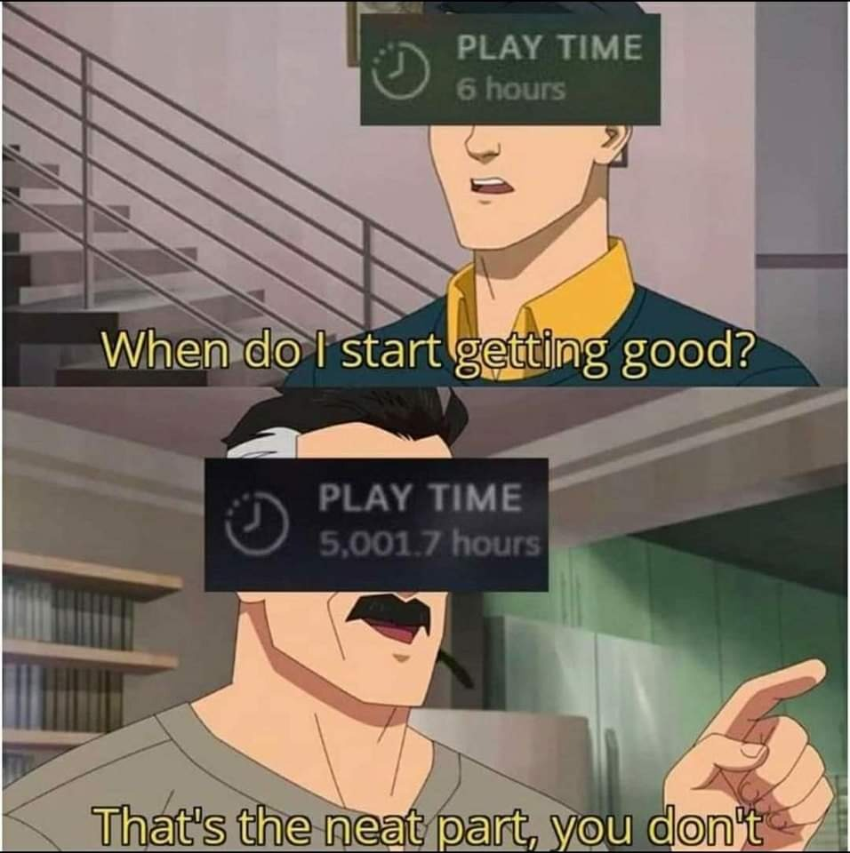
Why CCSO?
Mission: Bring up new hackers
Cyber and Engineering Majors:
Get ahead of your classes
Learn skills at warp speed
Meet people in the major
Business, Psych, Bio, etc Majors:
Understand threats in news
Improve your cyber hygiene
Improve your marketability for jobs
Expand your skill set
Get involved with likeminded students who love to learn!
Notes:
Alec

Slide 14

General Body
Meeting Info:
Biweekly Wednesdays 6-8PM
Held in the Cybertorium (most of the time)
Learn cybersecurity from the ground up
These meeting require no prior experience, just a willingness to come and learn
Membership Info:
Dues $30 / year | $20 / semester
Required to participate in Competitive Teams
Required to vote in club elections to make your voice heard
Required for other paid club events
Notes:
Liam

Slide 15

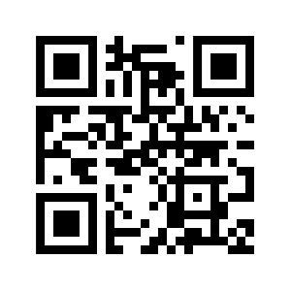
Comms
Discord is our primary chat platform
Announcements
Events
Be sure to select interests
Cool place to hang out
Select Interest Roles
Class rank
https://bit.ly/ccso-discord
Notes:
Brendan

Slide 16
CCSO & IST Career Opportunities
Sponsors want YOU
Corporate partner meetings
Technical workshops outside of GBM time to introduce you to new skills, and opportunities
Please attend, these help us fund travel & are great job opportunities!
Notes:
Liam

Slide 17
Planned Career Events
Deloitte Workshop
September 9th @ E208 6-8pm
Real world case studies & Job Opportunities
SRA Workshop
September 23rd @ E205 6-8pm
Topic TBD & Job Opportunities
Networking Event
Sept 24th @ 2nd Floor Westgate 6-8pm
CCSO Career Fair
Oct 16th @ 2nd Floor Westgate 10am-3pm

Slide 18



Current Sponsors

Slide 19
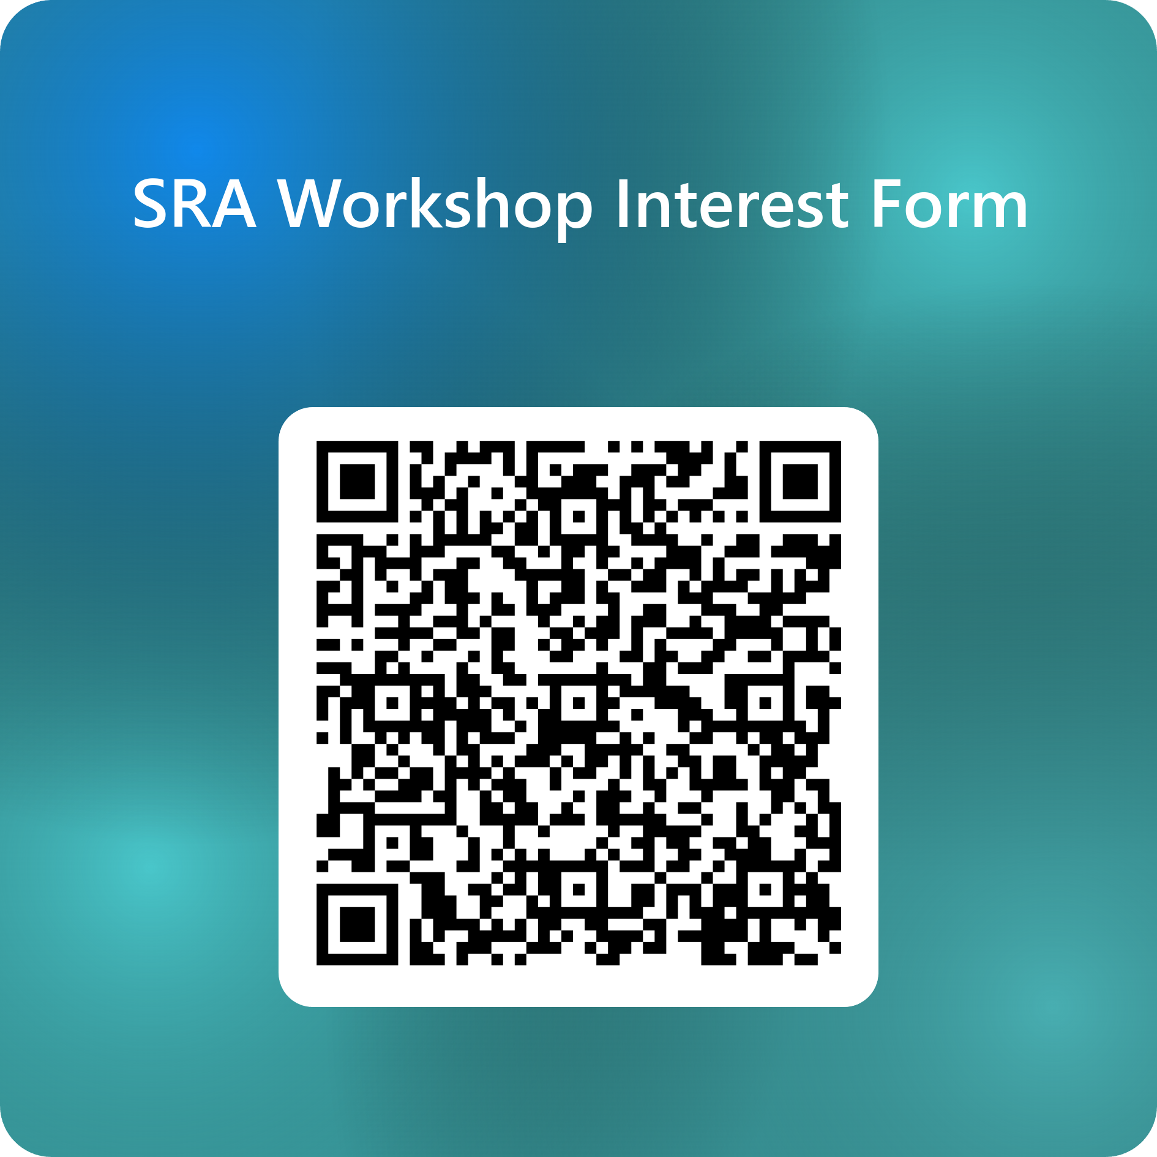
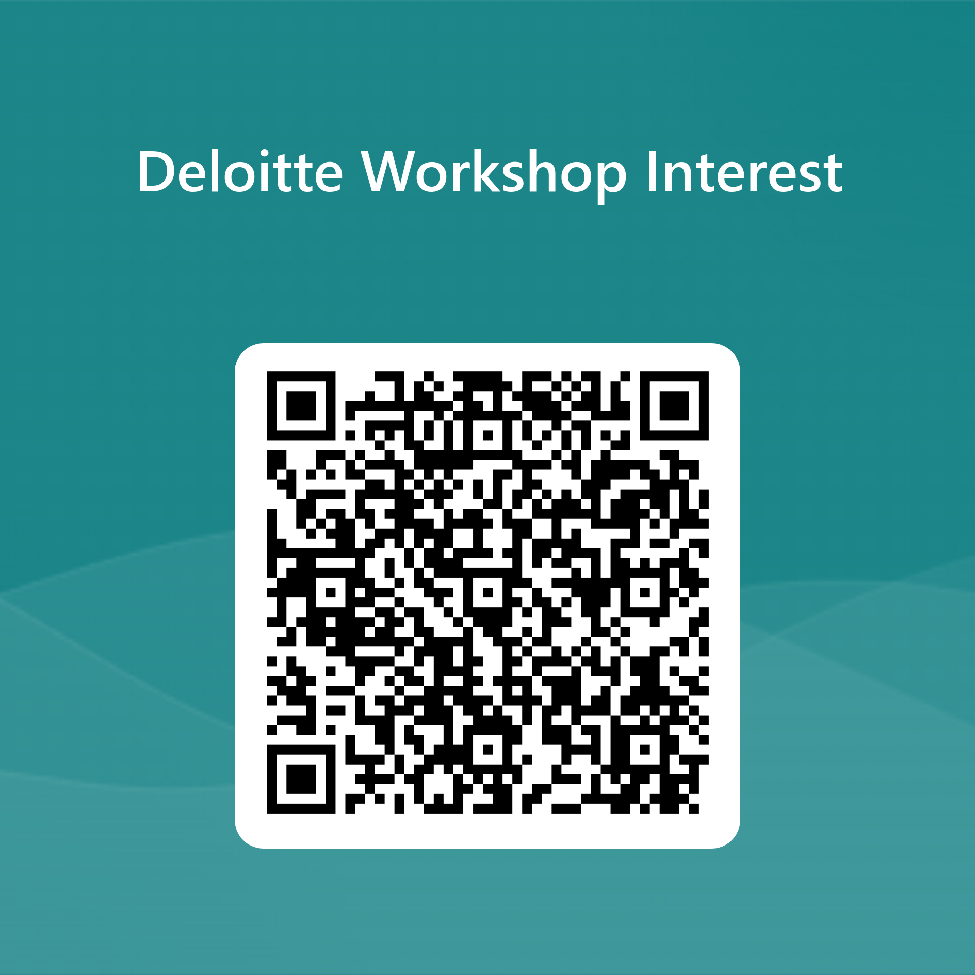
SRA Workshop Deloitte Workshop

Slide 20
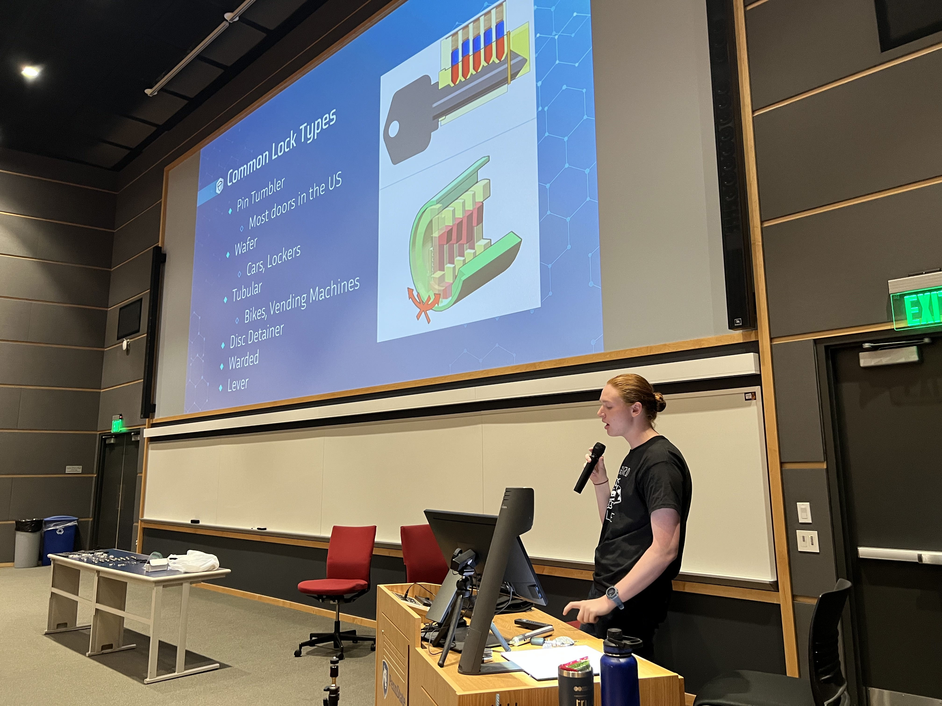
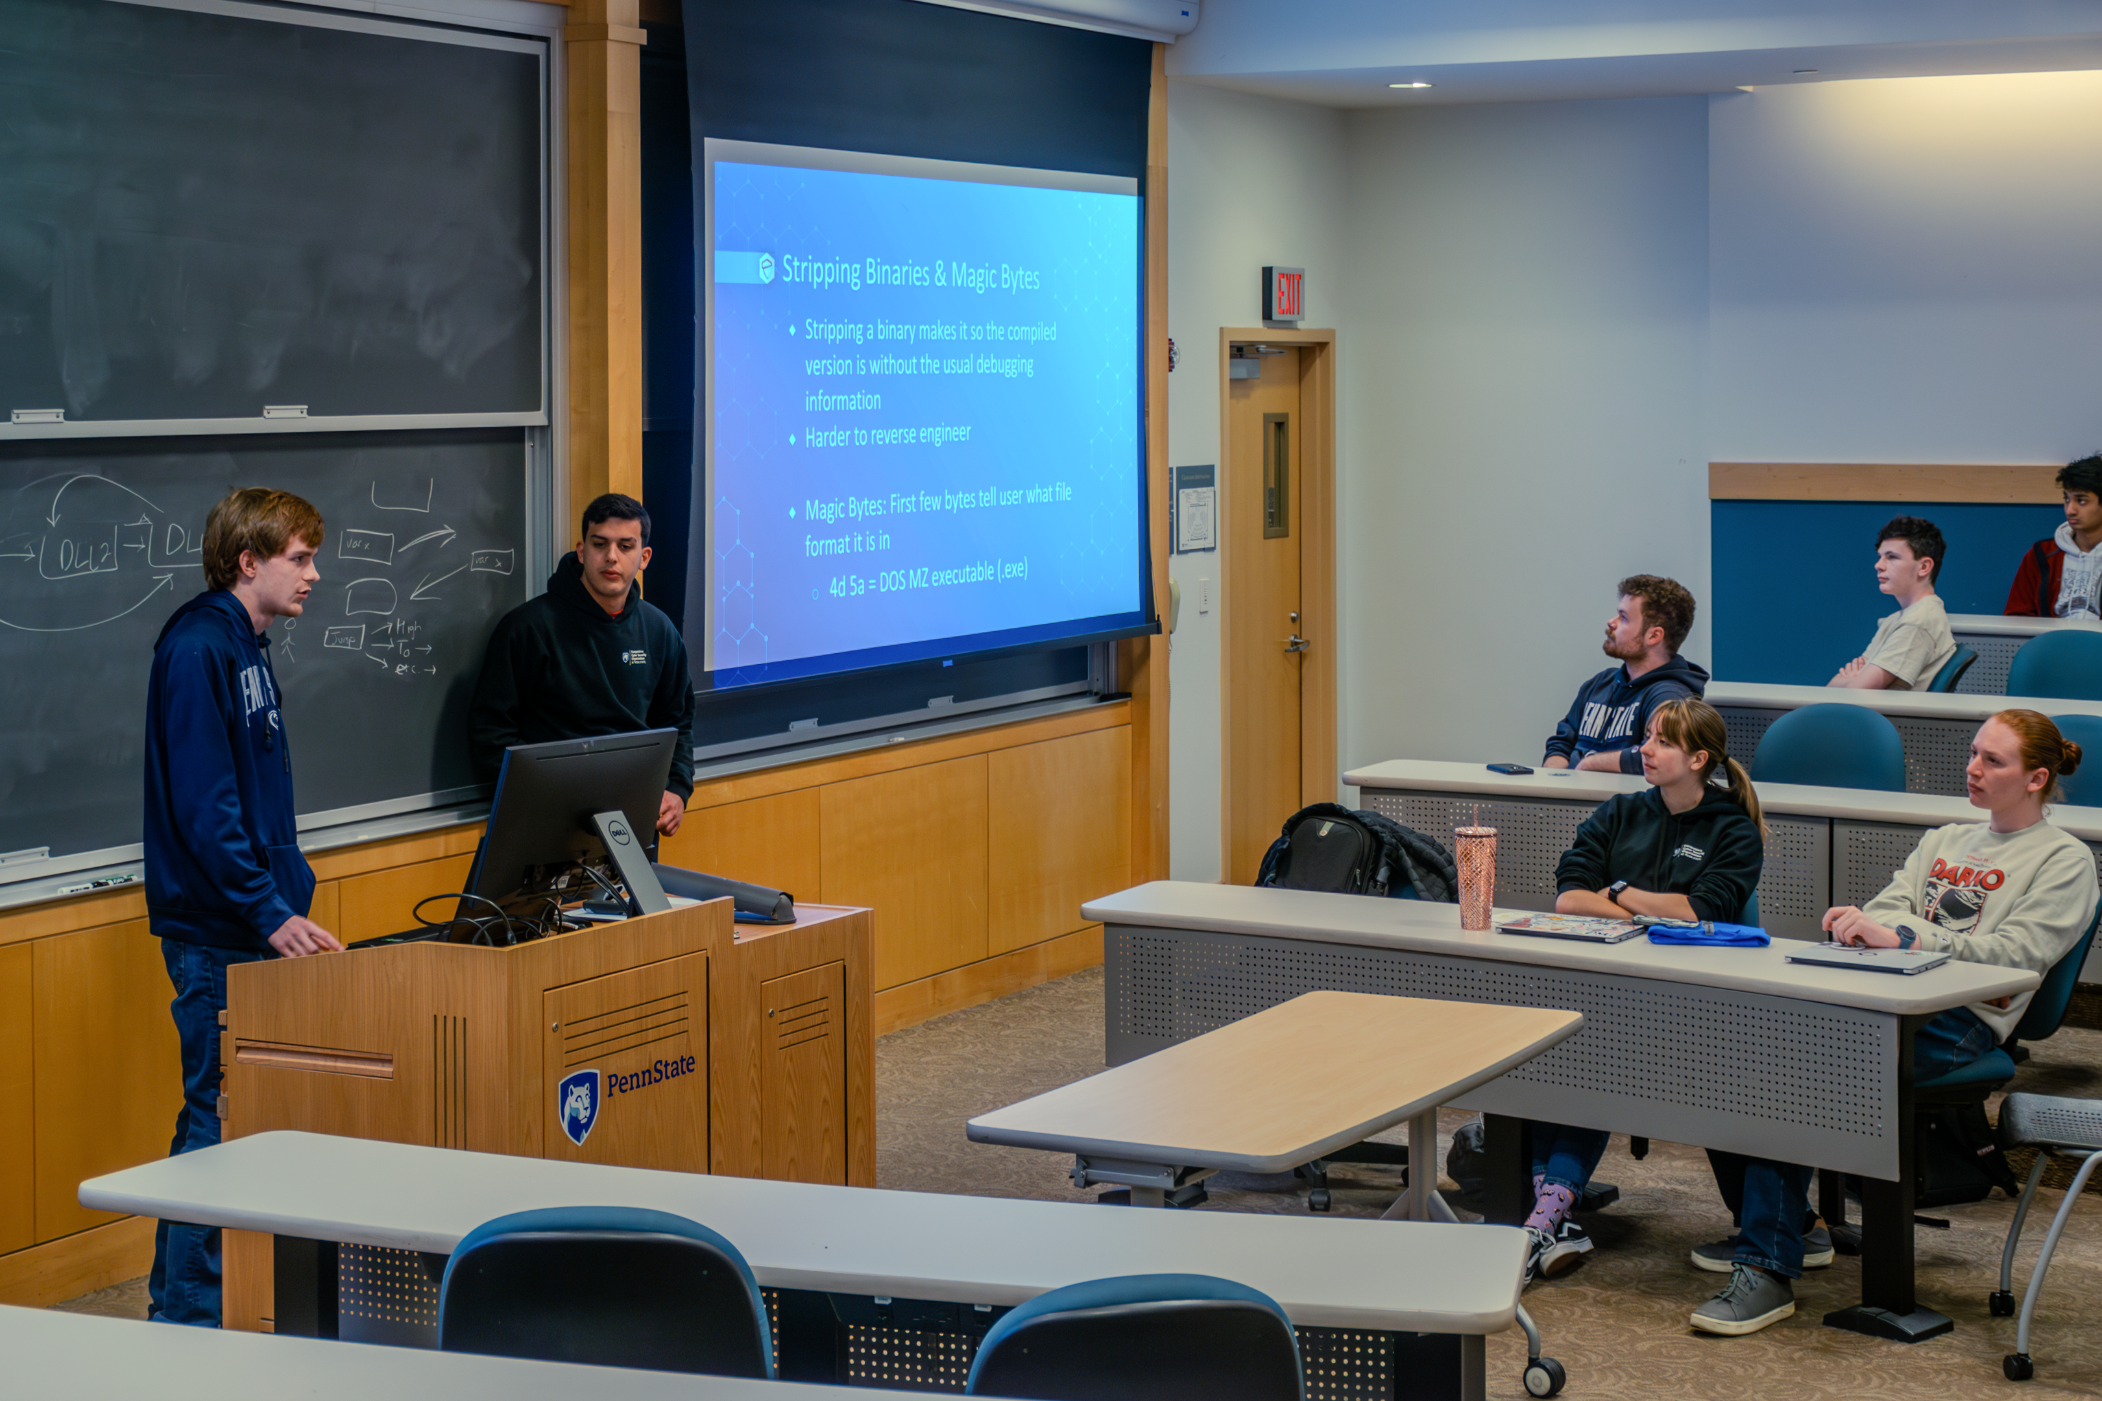




Things to look forward to:

Slide 21





Travel!

Slide 22
How to Pay Dues
$20 / semester
$30 for full year
Payment methods
Venmo preferred @imasso510
Cash
Checks made to:
Competitive Cybersecurity
Organization
Notes:
Jenna

Slide 23

This Year’s Topics
First Meeting (You’re here!)
Pentest Methodology
SIEMs
Lockpicking
System Hardening & IR
OSINT
Reverse Engineering
CTF Prep
IoT Security
What else do you want to see?​
Notes:
Jenna

Slide 24


Defensive Competitions (Blue Team)
Learn to protect computer networks
Respond to security breaches (Incident Response)
Competitions:
Collegiate Cyber Defense Competition
Department of Energy CyberForce
Hivestorm
And more!
Notes:
Impact and effects of a hack
What does this do to core buisness function

Slide 25



Offensive Team (Red Team)
Penetration Testing
Learn to hack into computer systems (legally)
Different Hacking Techniques & Methodologies
OSINT
Enumeration
Exploitation
Web-App Attacks
Competitions:
Collegiate Penetration Testing Competition
Hack the Building
and more!
Notes:
Josh

Slide 26






Capture the Flags (CTFs)
Solve cyber challenges across a variety of topics
Cryptography
Open-source intelligence
Web application exploitation
Reverse engineering
… and more!
Learn new weird things
File types
Types of encoding
Network protocols
Notes:
Josh

Slide 27



Upcoming Competitions
CPTC
Hivestorm
CyberForce

Slide 28


CTFd
Challenges portal
Released most meetings
Randomly throughout year
Reward for top scorers
Low stakes
Instruction to register on home page
https://wiki.psuccso.org/introduction/ctfd
https://ctf.psuccso.org/
Notes:
Brendan

Slide 29



Next Meeting - (9/11)
Wednesday September 11th, 6-8 PM, Thomas 102 (This time only)
Pentest Methodology!
Learn about the penetration testing process.
Notes:
Liam

Slide 30


Breakout Time
wiki.psuccso.org > "Getting Started"
Option A – Newcomers
VM Setup
Single Sign On (SSO)
& CTF Setup
Questions & Help
Option B – Returners
Migrate to room E201
Intro CTF
Prizes!
VM Setup
SSO Setup

